Slide 1
Current Status of Treatment for Vulvar Cancer
Sven Mahner, MD, PhD
University Medical Center Hamburg-Eppendorf
AGO Study Group
Hamburg, Germany

Slide 2

Key Aspects of Vulvar Cancer Treatment:
Surgery of the vulva
Surgery of the groin
Adjuvant treatment

Slide 3
Key Aspects of Vulvar Cancer Treatment:
Surgery of the vulva
Surgery of the groin
Adjuvant treatment

Slide 4
Image not available

Slide 5
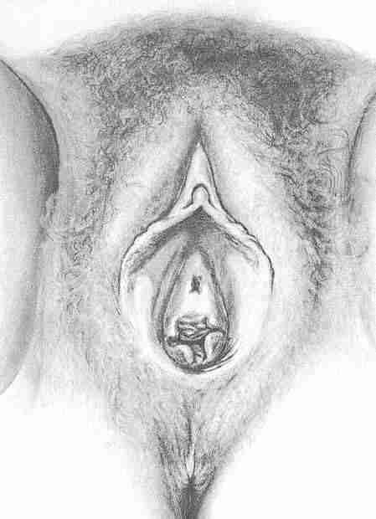
Typical Localization of Vulvar Cancer

Slide 6
Typical Localization of Vulvar Cancer

Slide 7
Typical Localization of Vulvar Cancer

Slide 8
Surgical Resection of Vulvar Cancer
Depending on the tumor localization,
different resection and reconstruction strategies are necessary

Slide 9
Resection And Reconstruction at the Posterior Vulva – Limberg Flaps

Slide 10
Resection And Reconstruction at the Posterior Vulva – Limberg Flaps

Slide 11
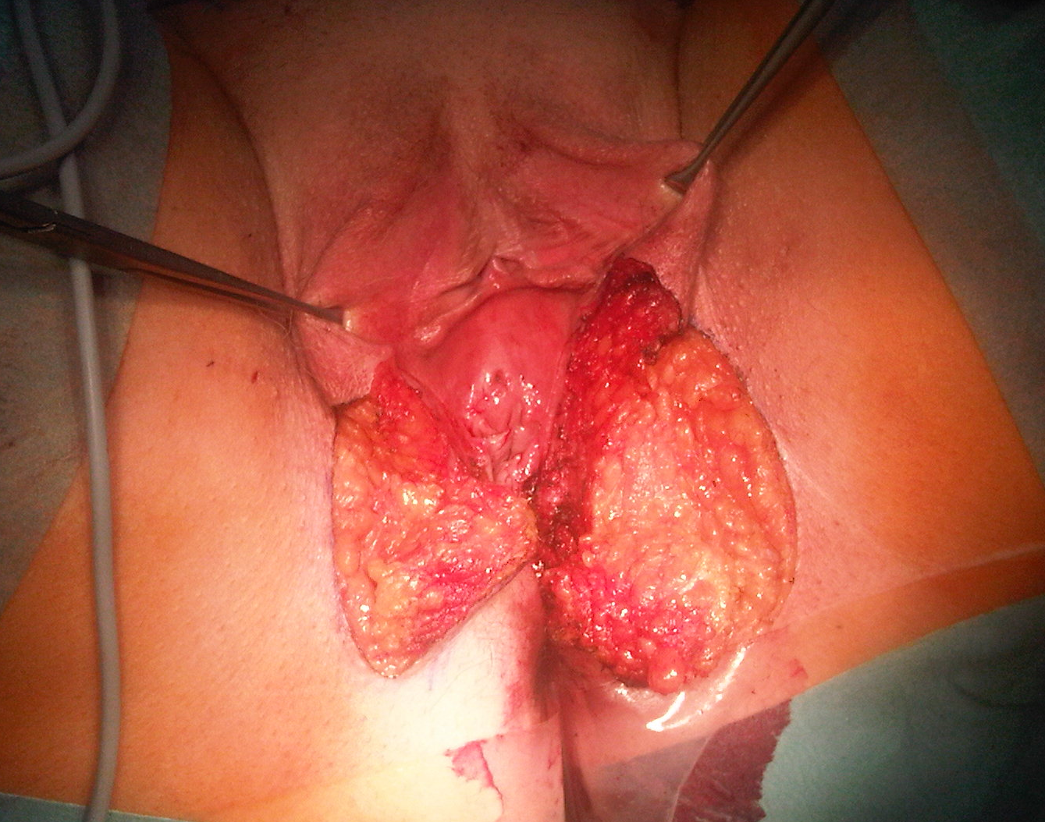
© Sven Mahner 2015

Slide 12
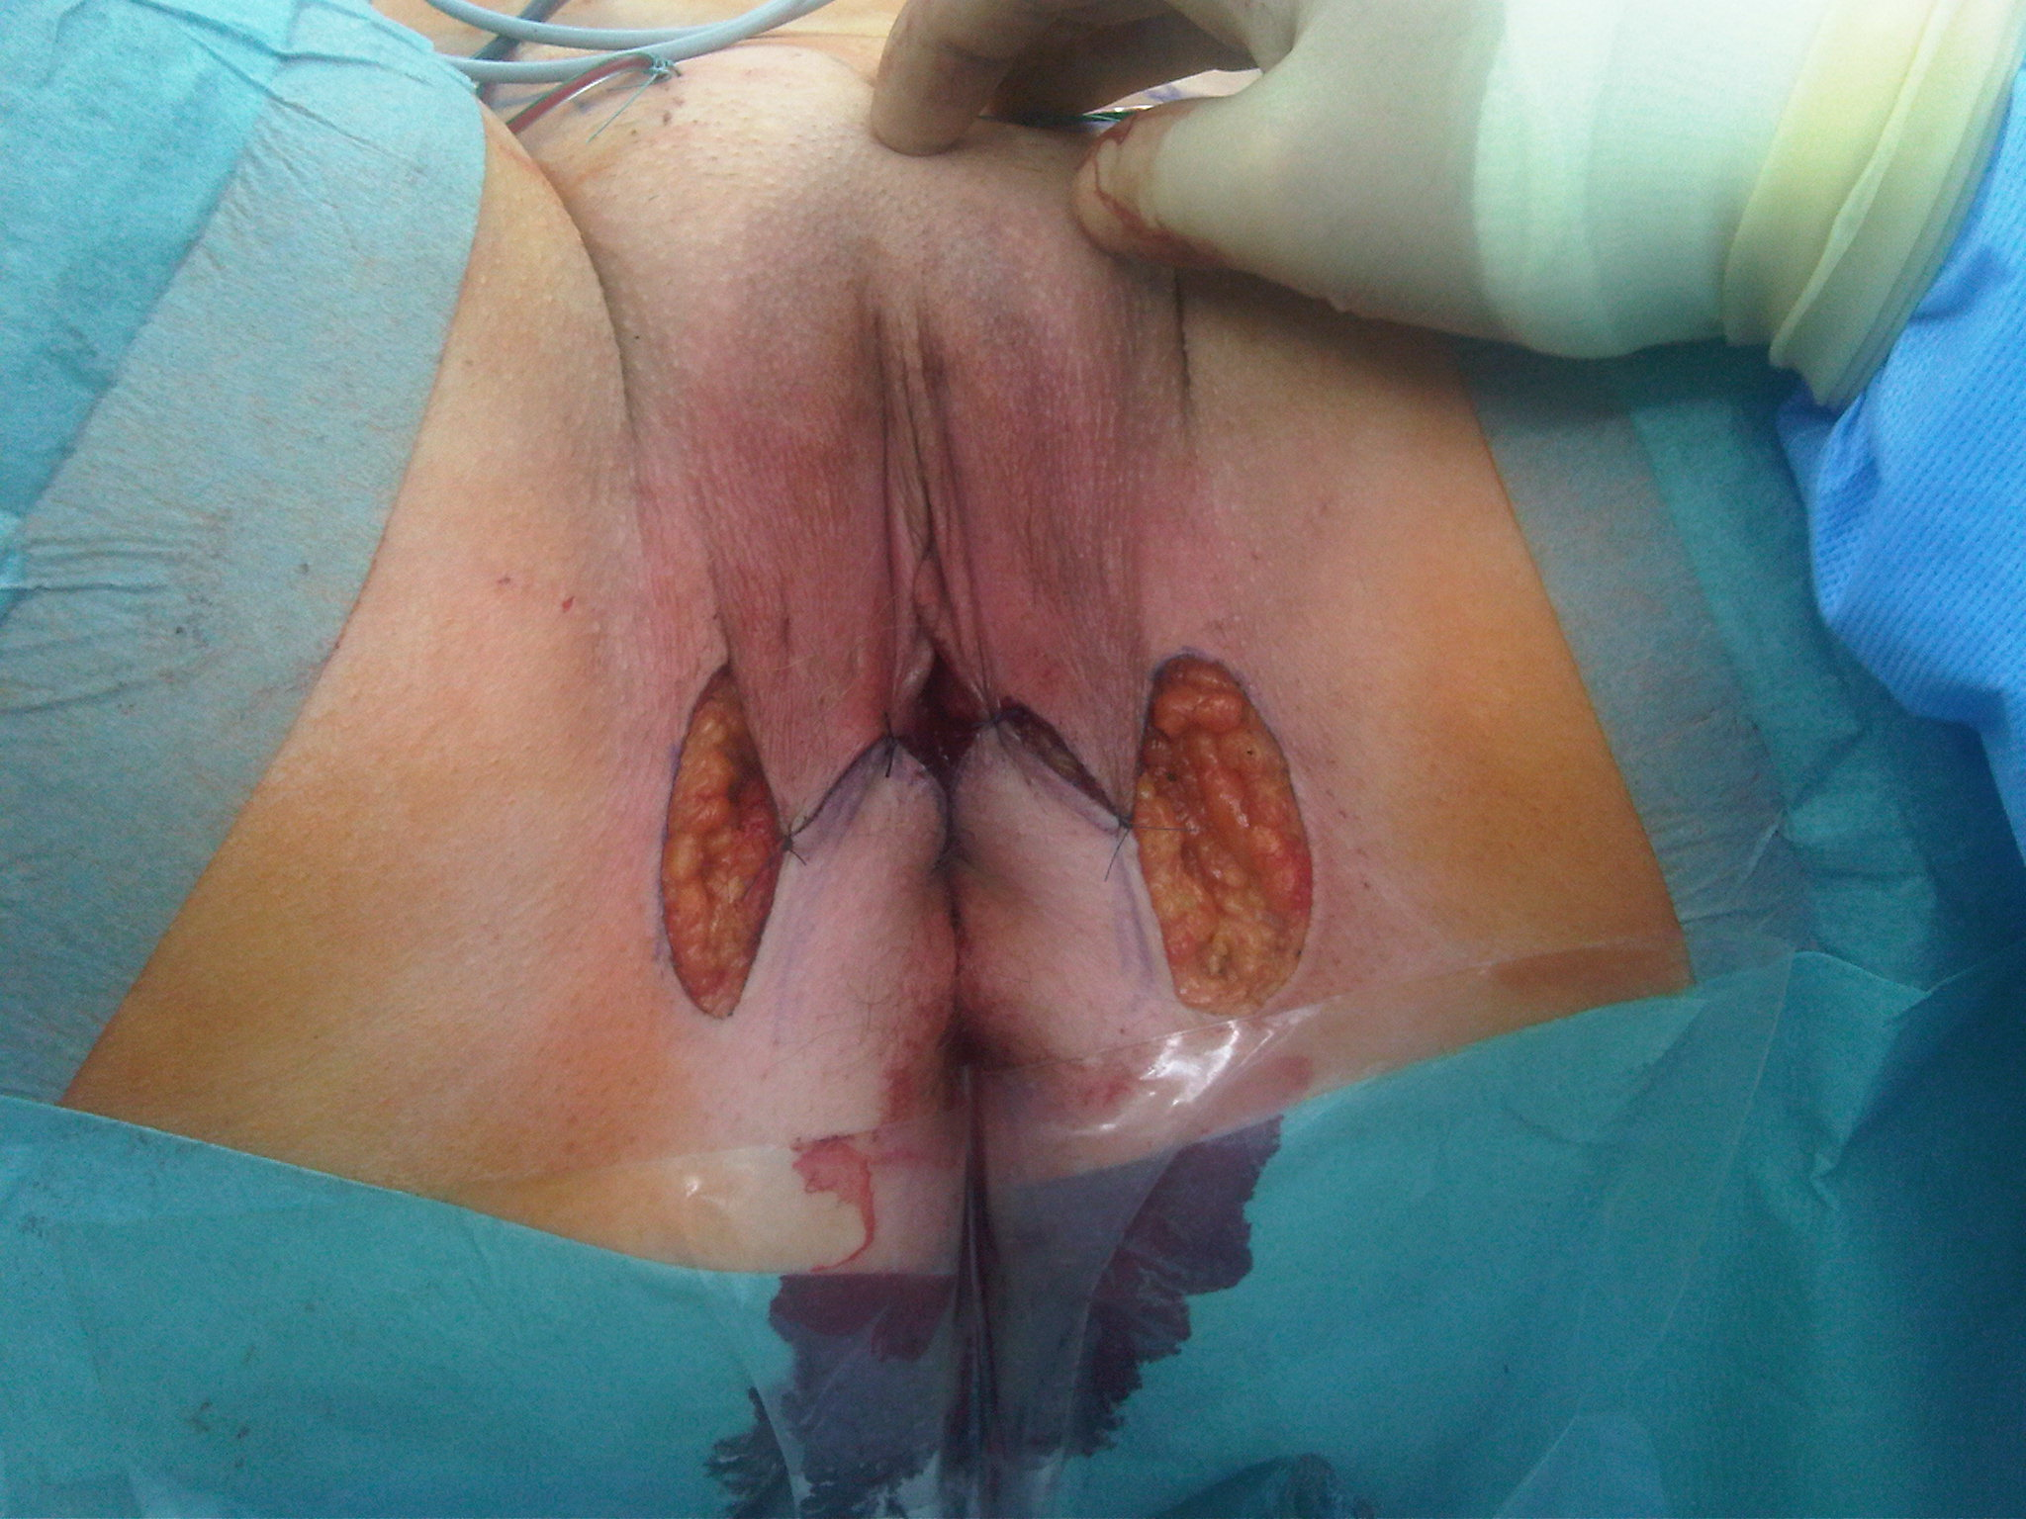
© Sven Mahner 2015

Slide 13
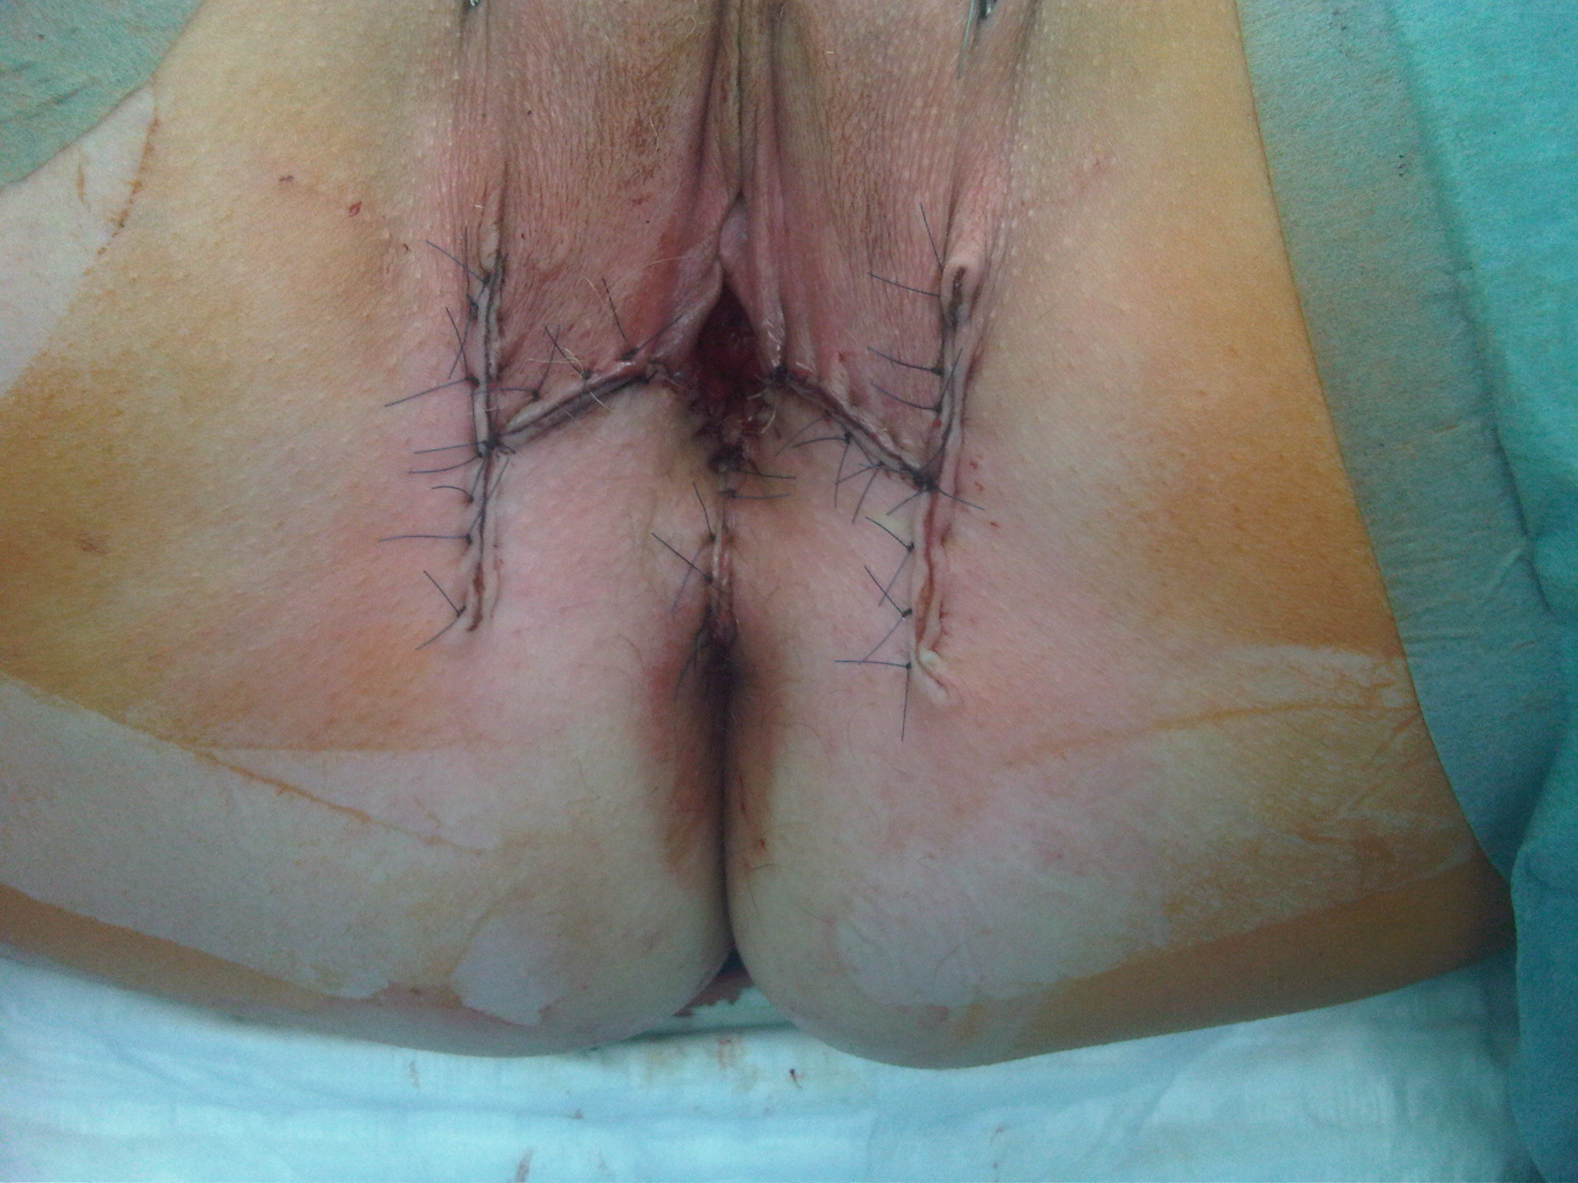
© Sven Mahner 2015

Slide 14
Image not available

Slide 15
Resection And Reconstruction at the Posterior Vulva – Gluteal Fold V-Y Advancement Flaps

Slide 16
Resection And Reconstruction at the Posterior Vulva – Gluteal Fold V-Y Advancement Flaps

Slide 17
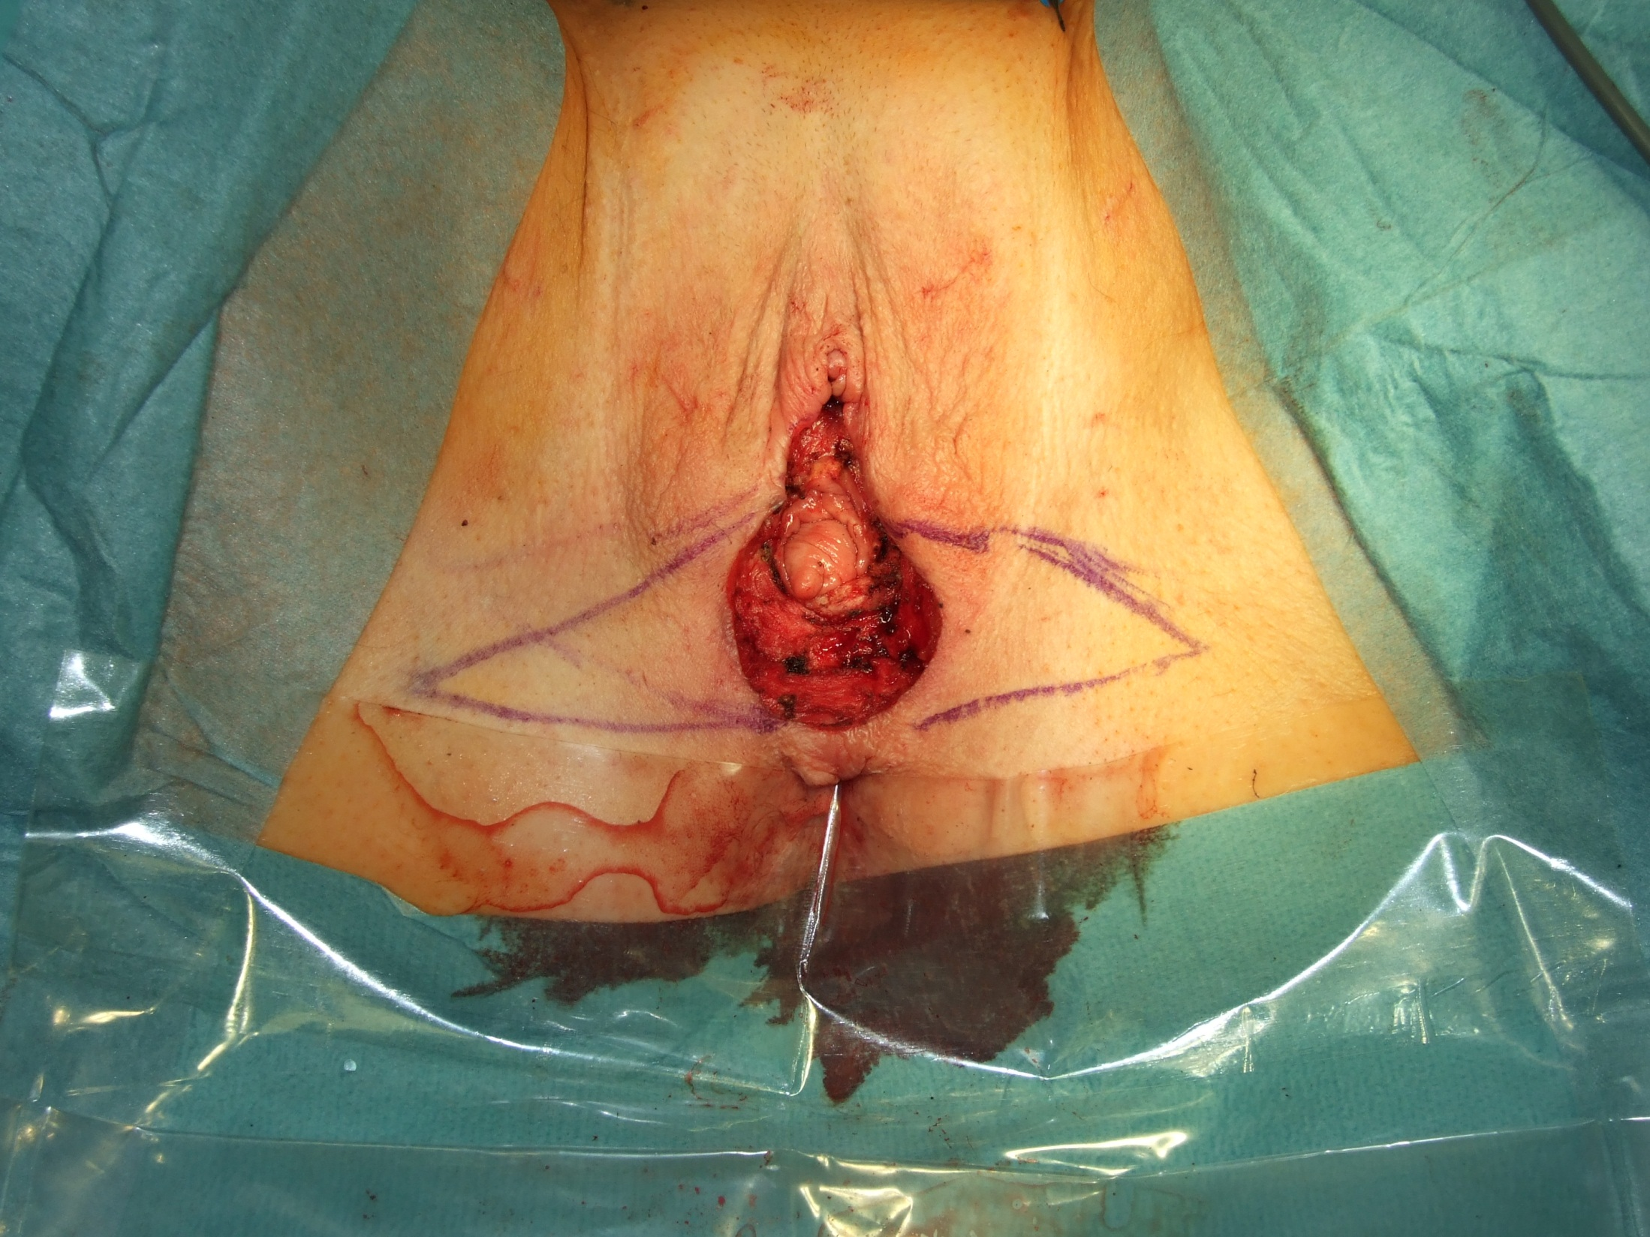
© Sven Mahner 2015

Slide 18
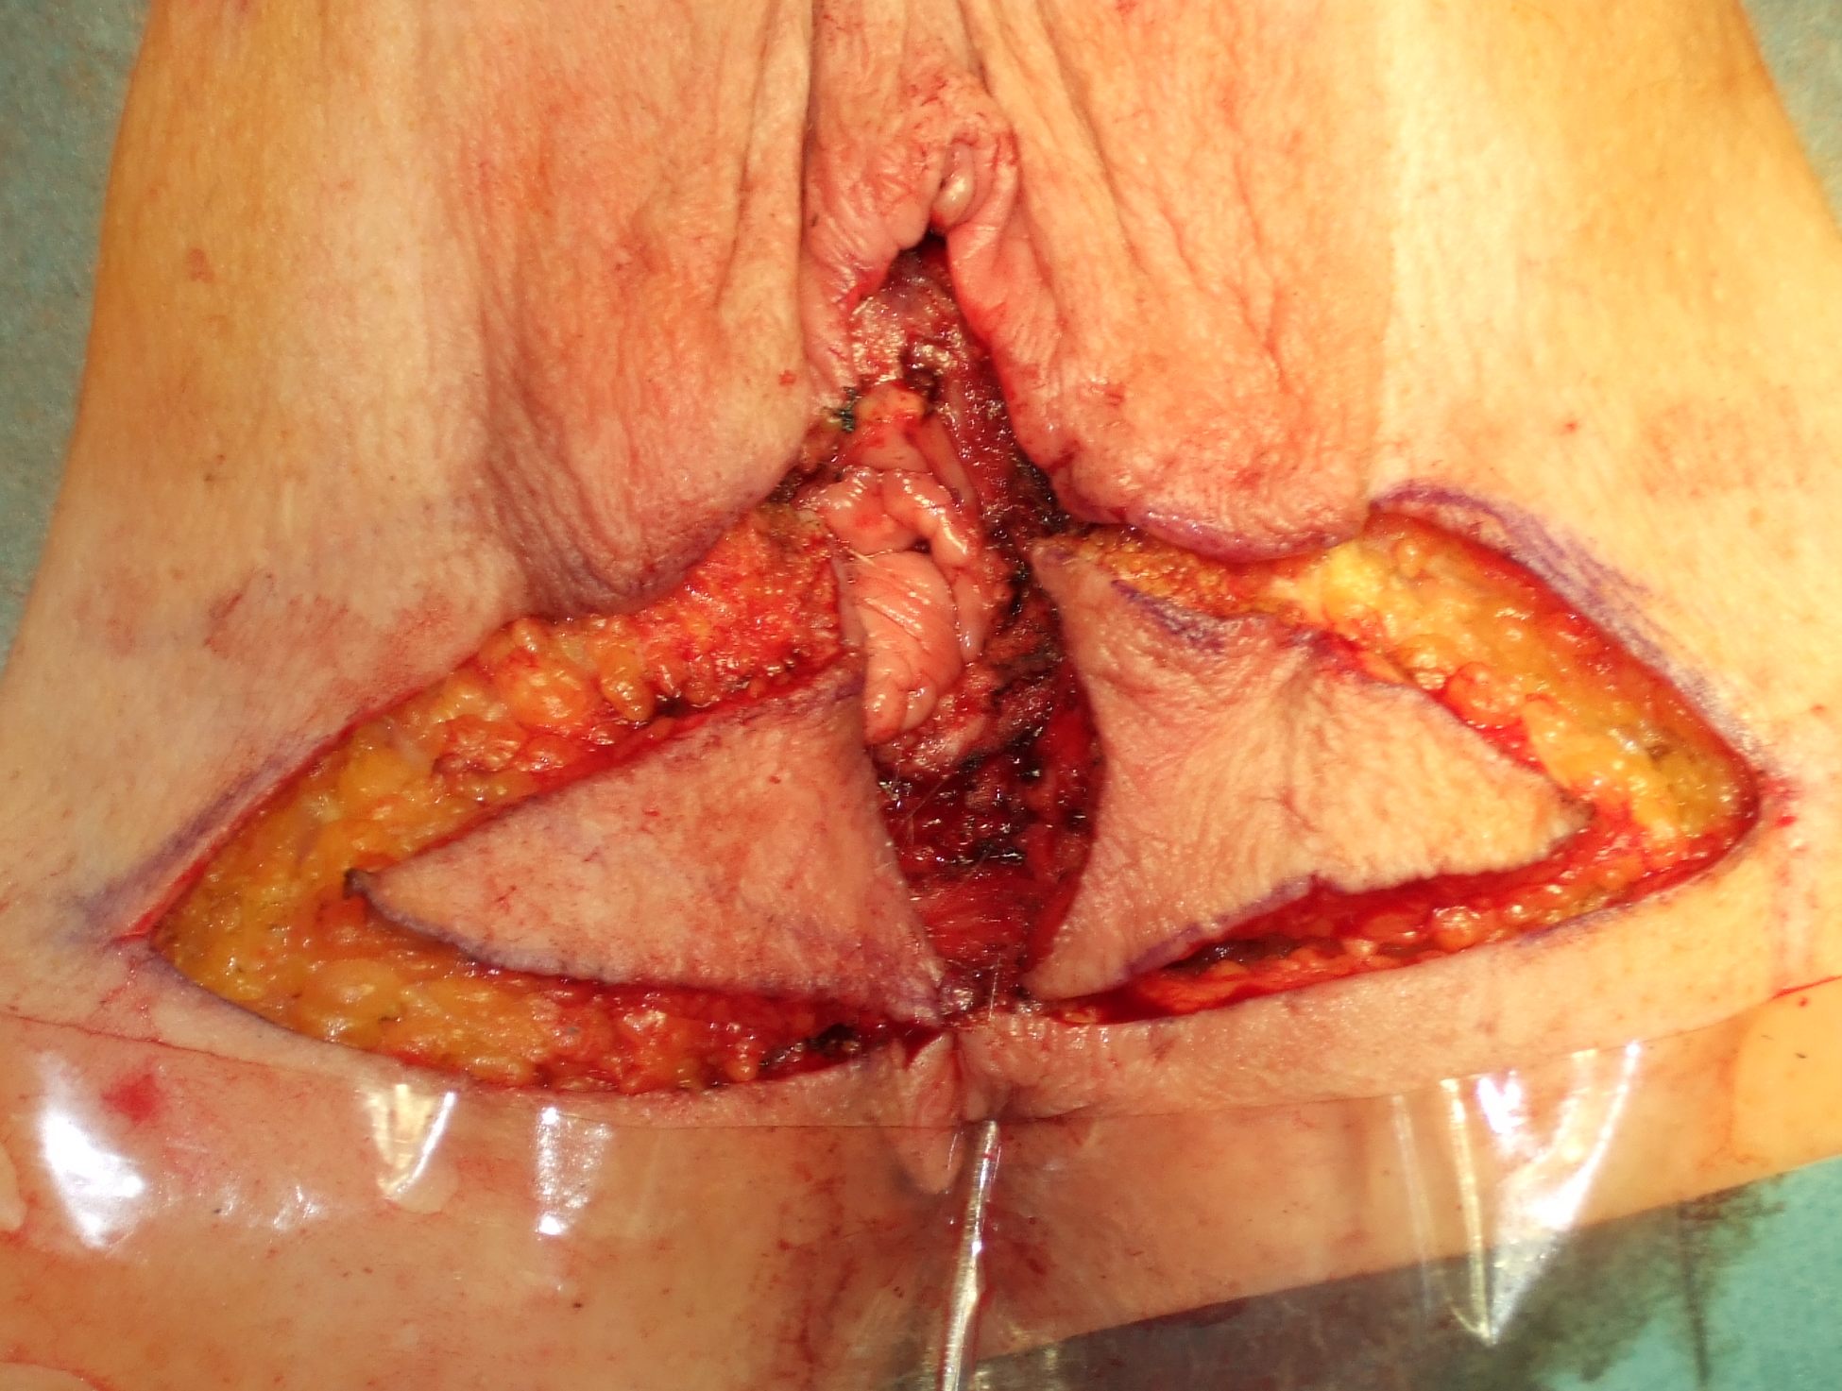
© Sven Mahner 2015

Slide 19
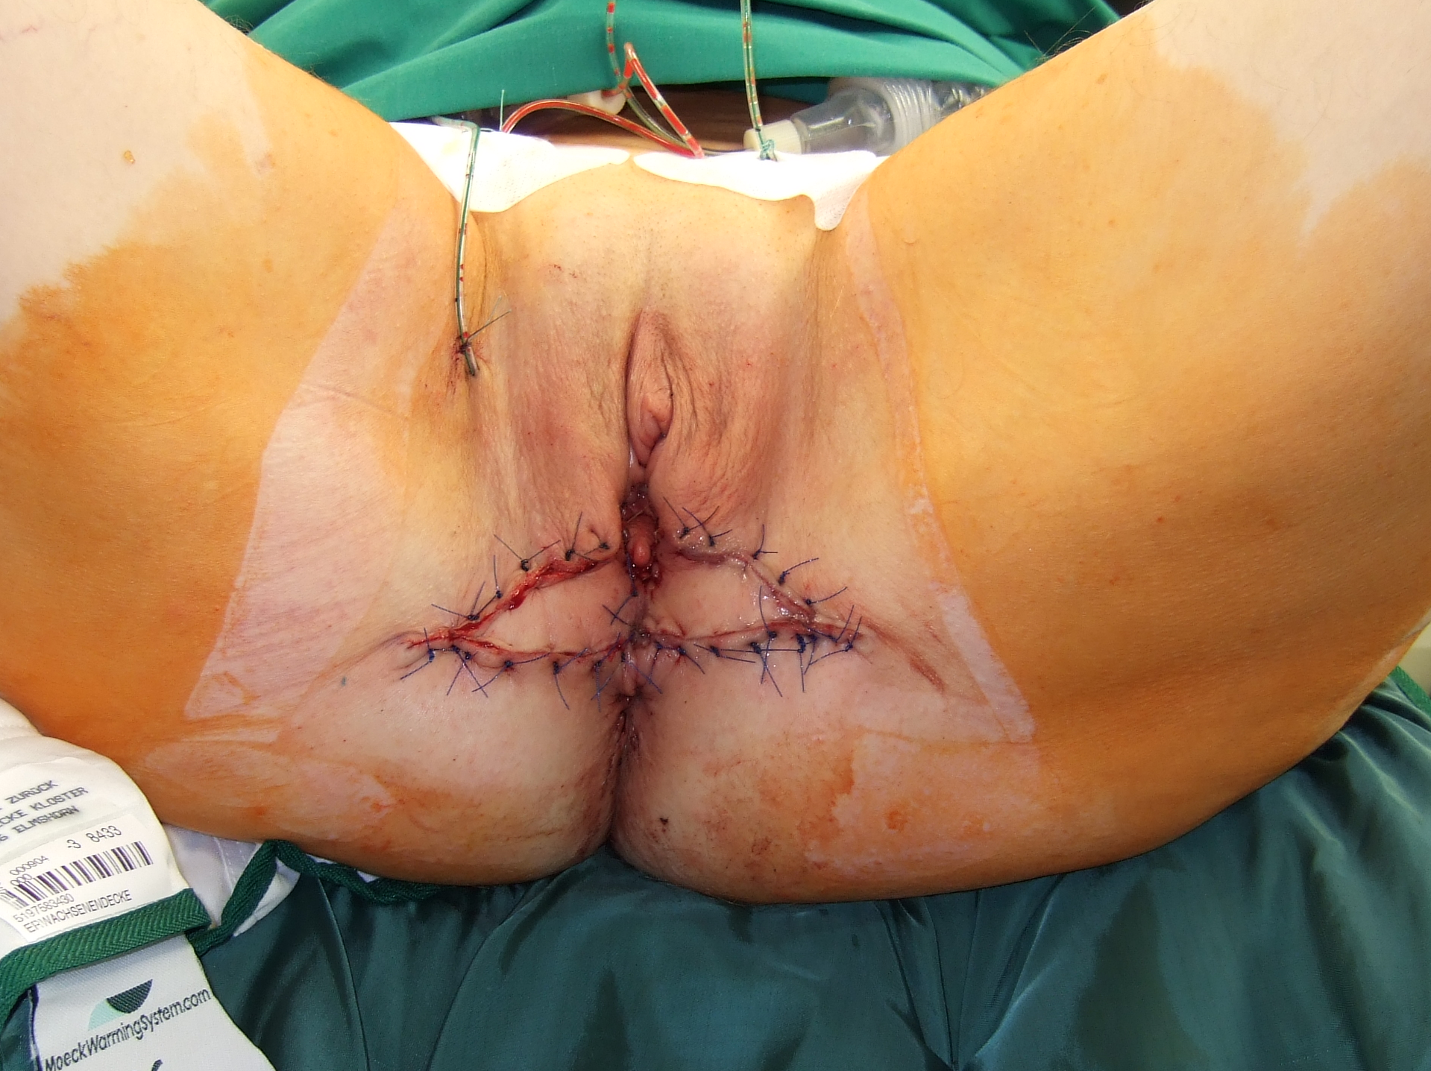
© Sven Mahner 2015

Slide 20
Resection and Reconstruction at the Anterior Vulva – Limberg Flaps

Slide 21
Resection and Reconstruction at the Anterior Vulva – Limberg Flaps

Slide 22
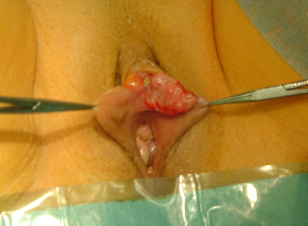
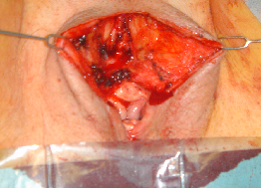
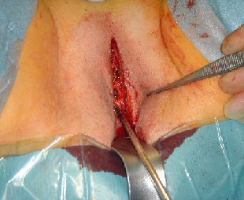
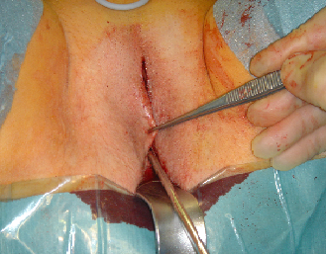
© Sven Mahner 2015

Slide 23
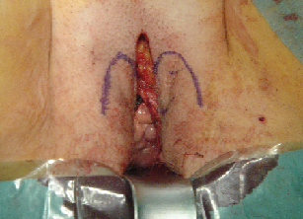
Kutane Transpositionslappen

Slide 24
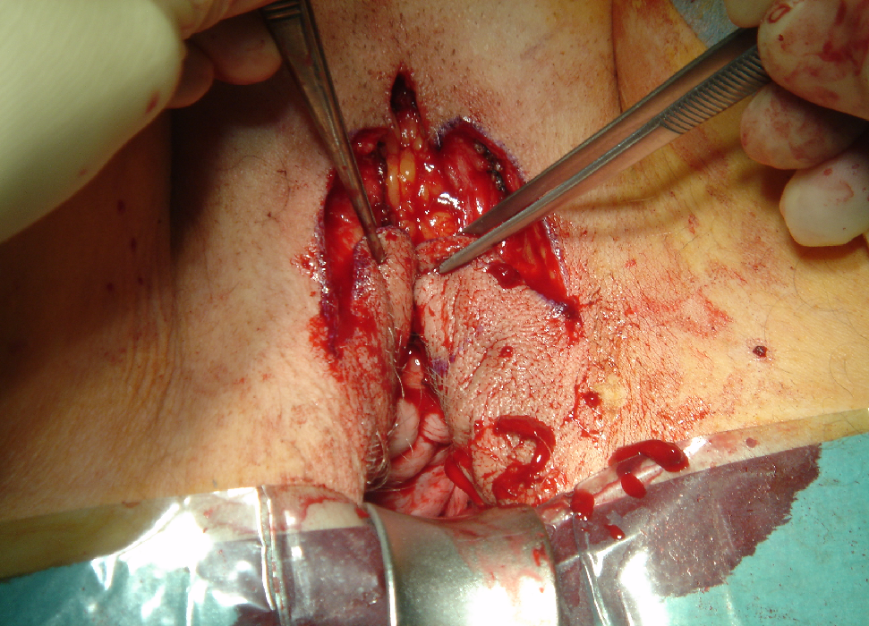
© Sven Mahner 2015

Slide 25
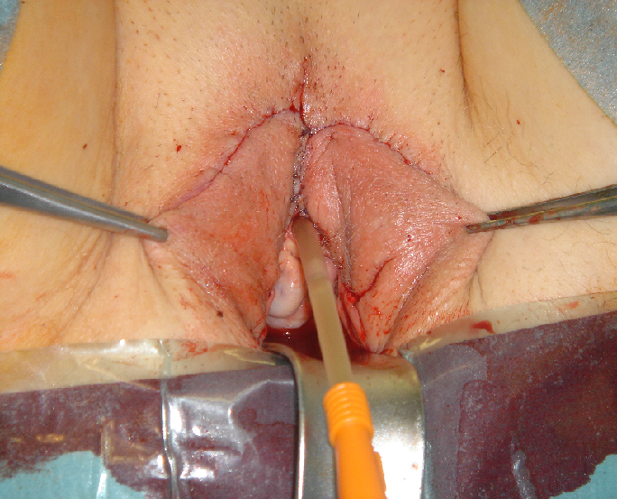
© Sven Mahner 2015

Slide 26
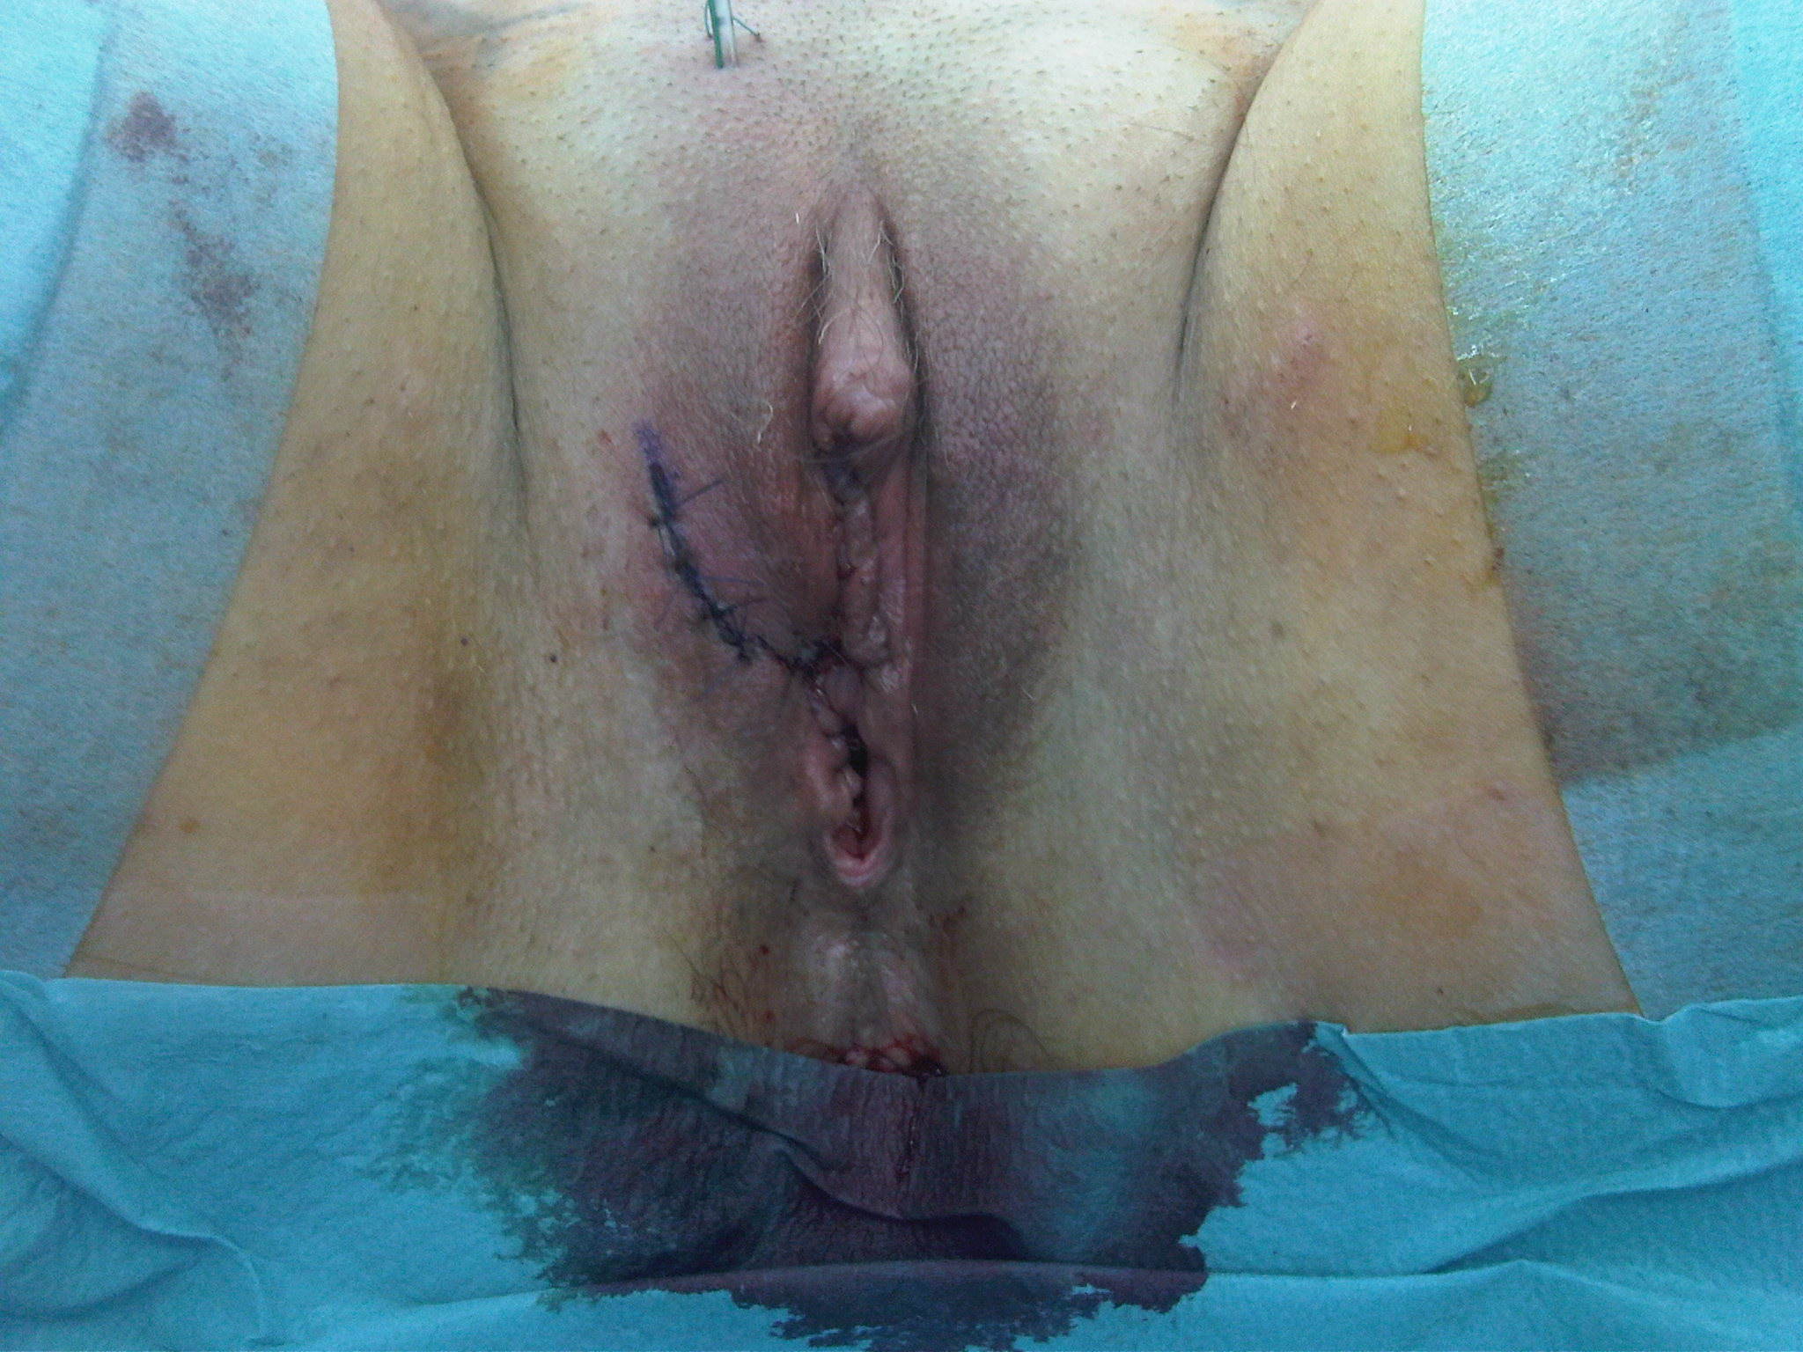
© Sven Mahner 2015

Slide 27
Resection and Reconstruction of Large and Multifocal Vulvar Cancer – Pubo-Labial V-Y Advancement Flap

Slide 28
Resection and Reconstruction of Large and Multifocal Vulvar Cancer – Pubo-Labial V-Y Advancement Flap

Slide 29
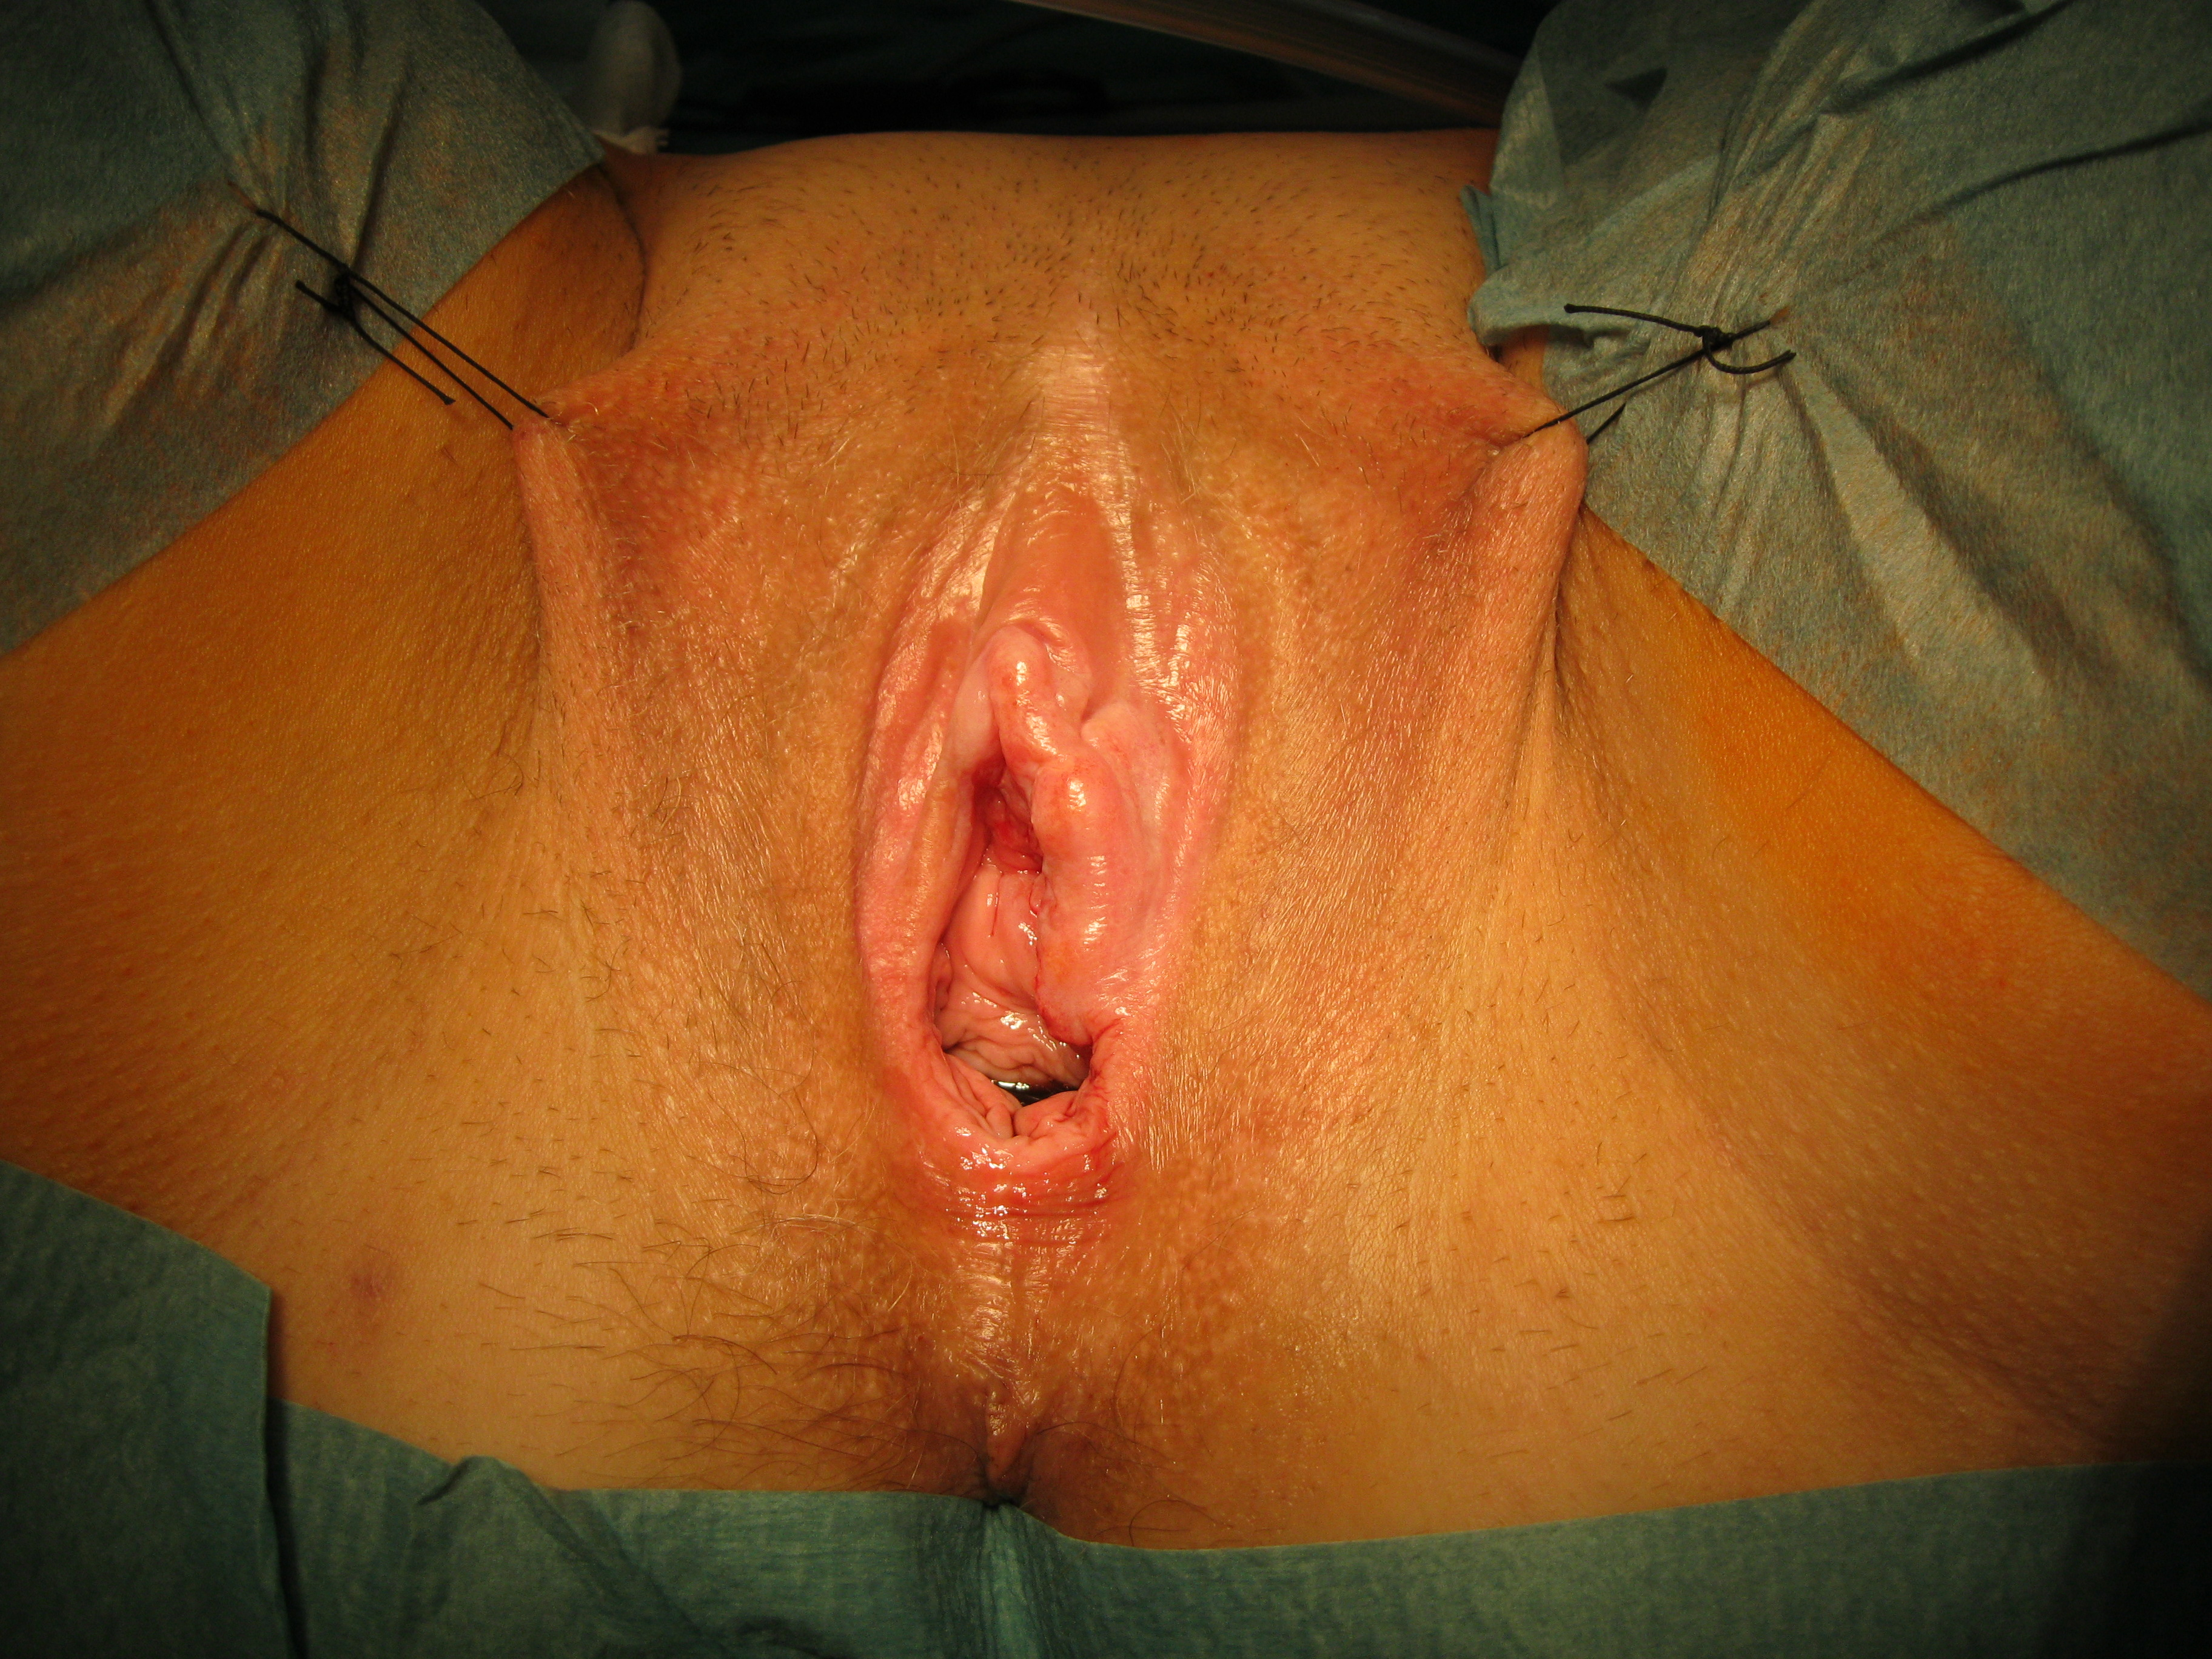
© Sven Mahner 2015

Slide 30
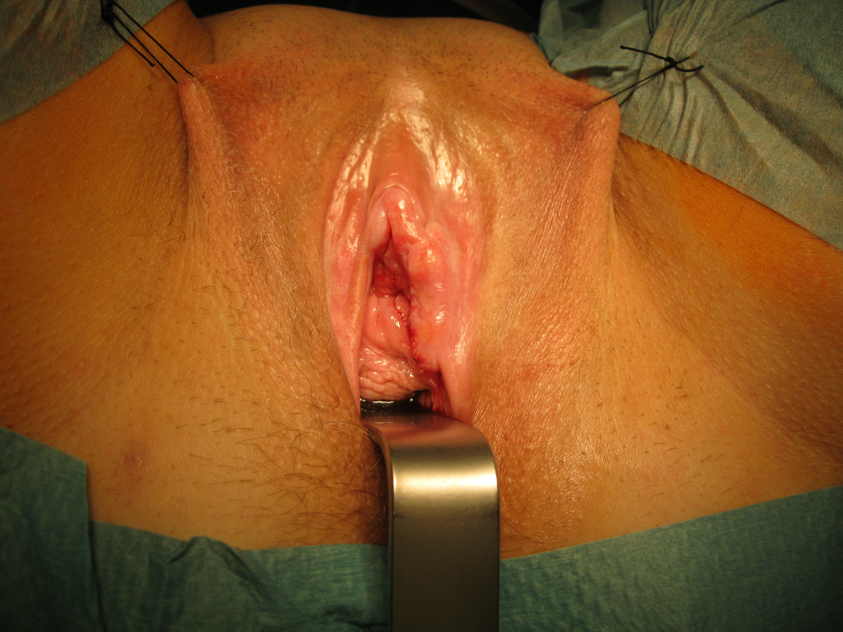
© Sven Mahner 2015

Slide 31
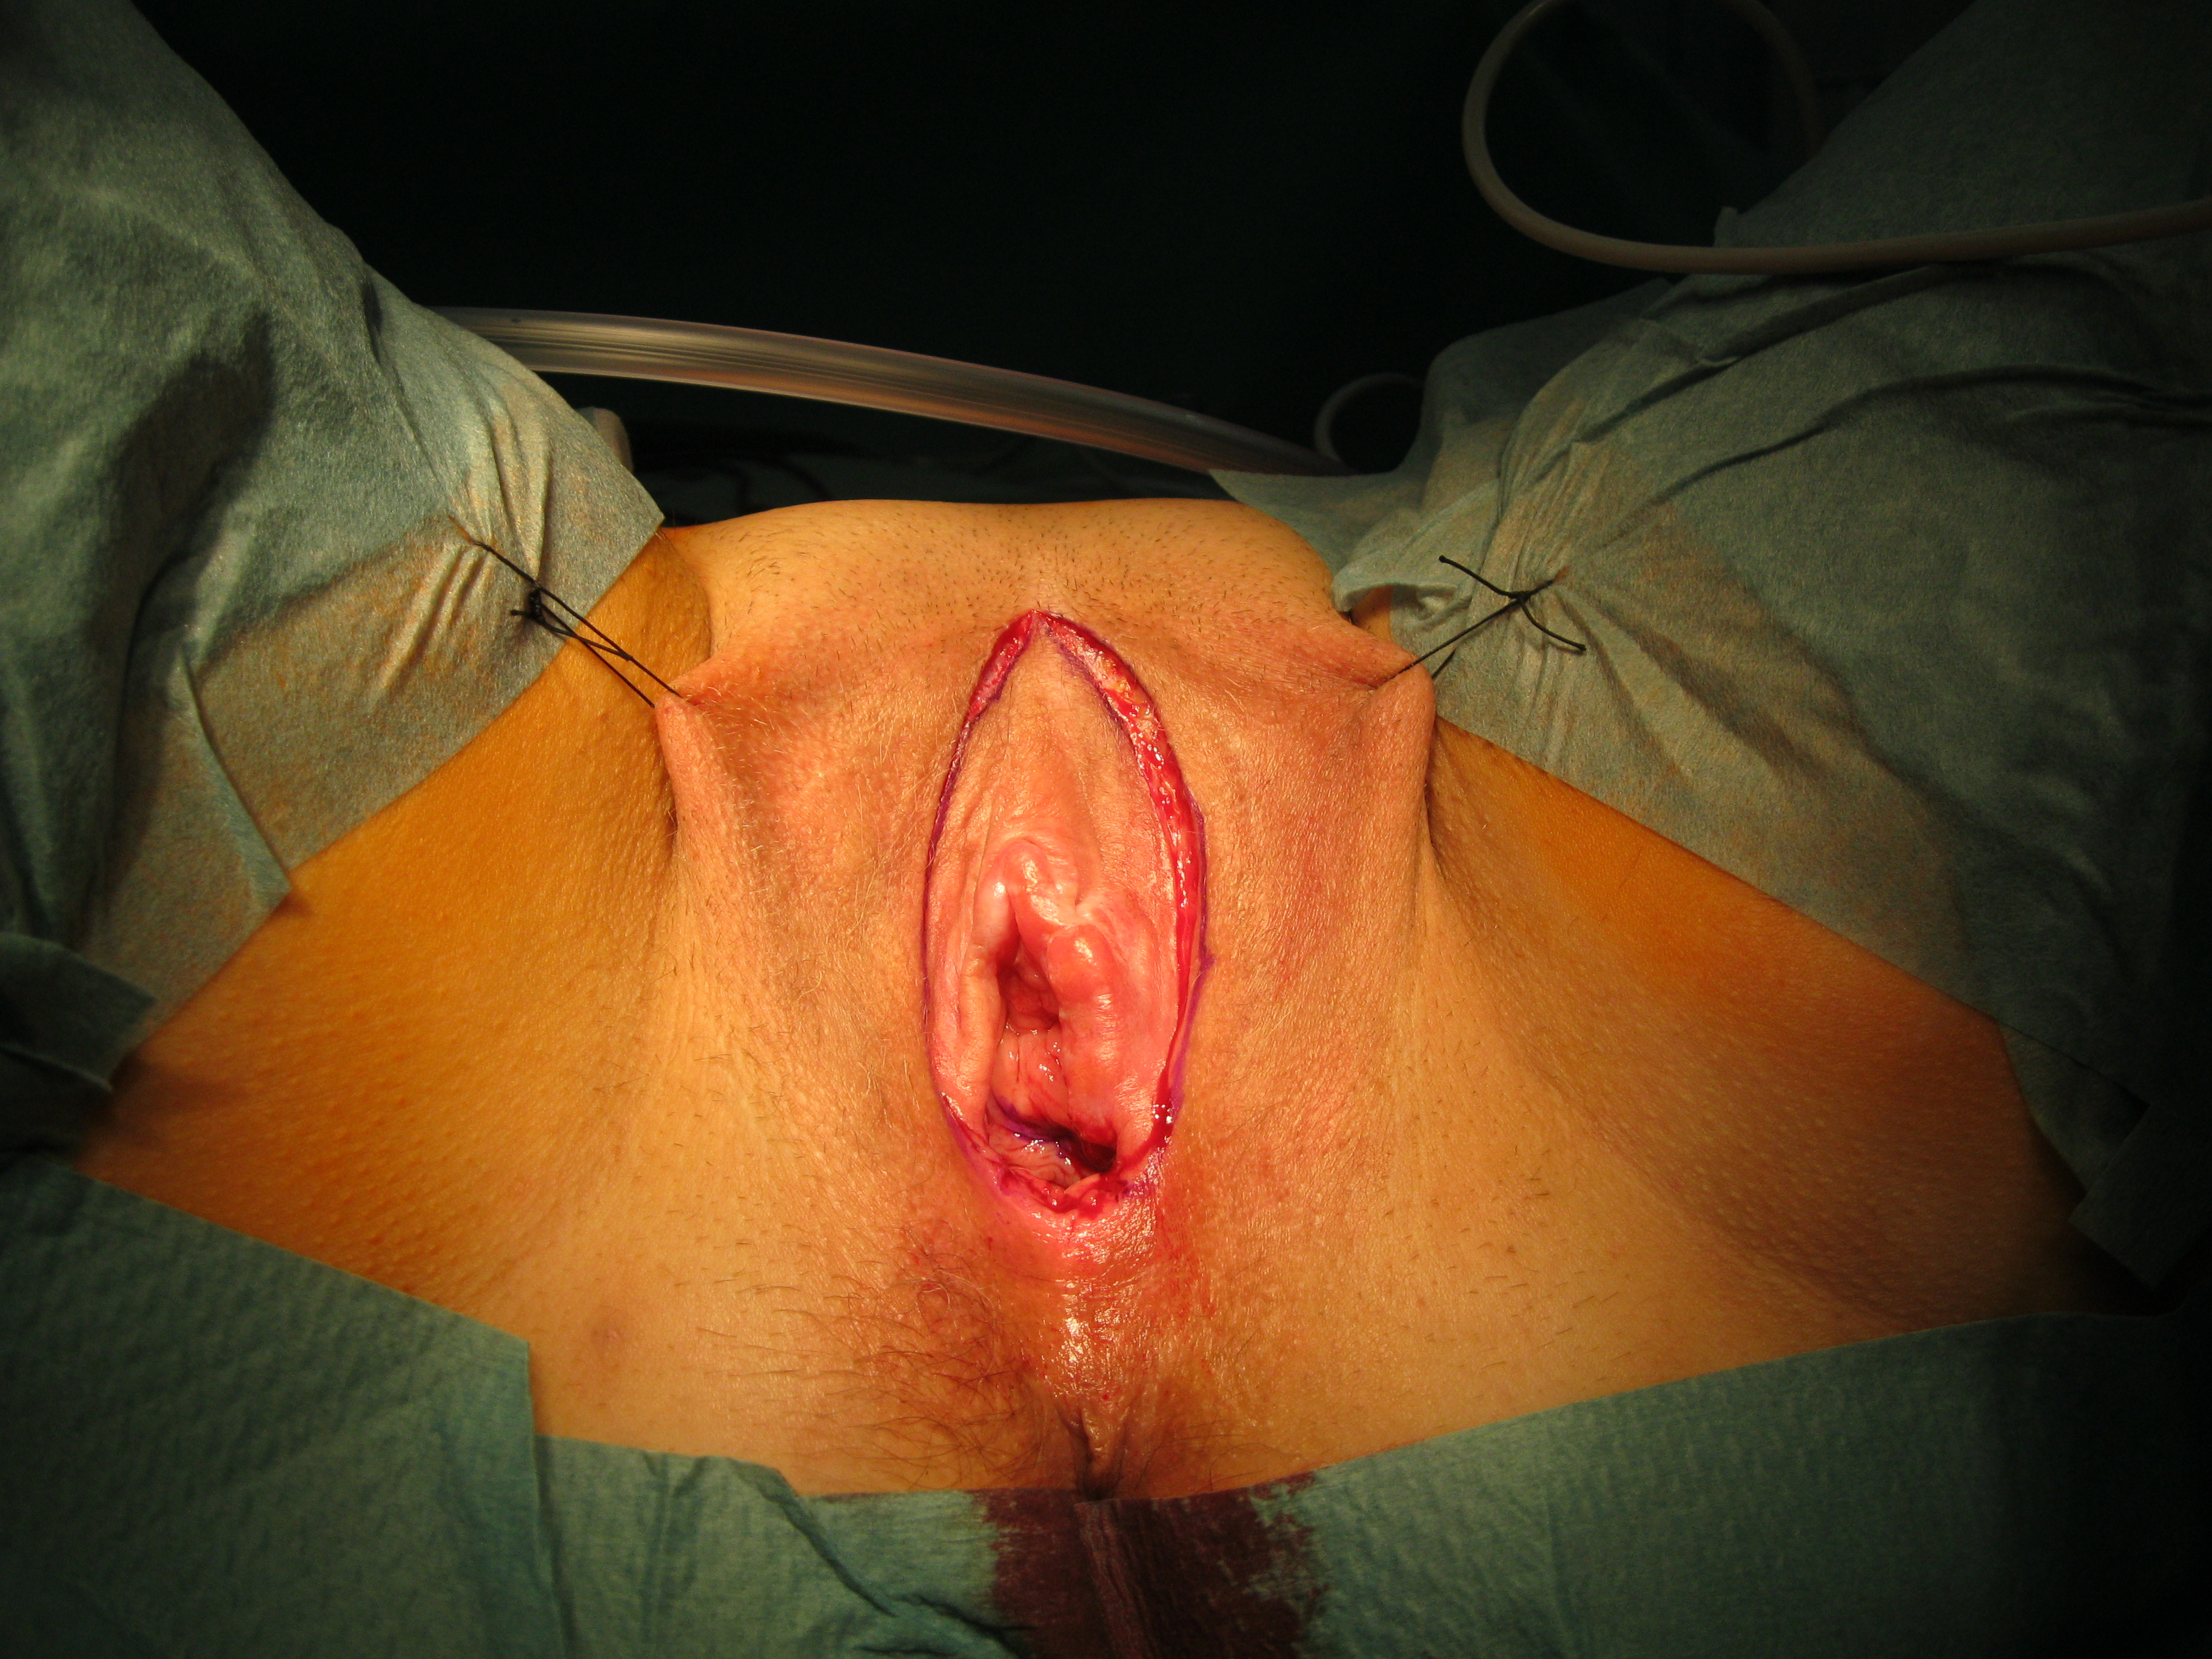
© Sven Mahner 2015

Slide 32
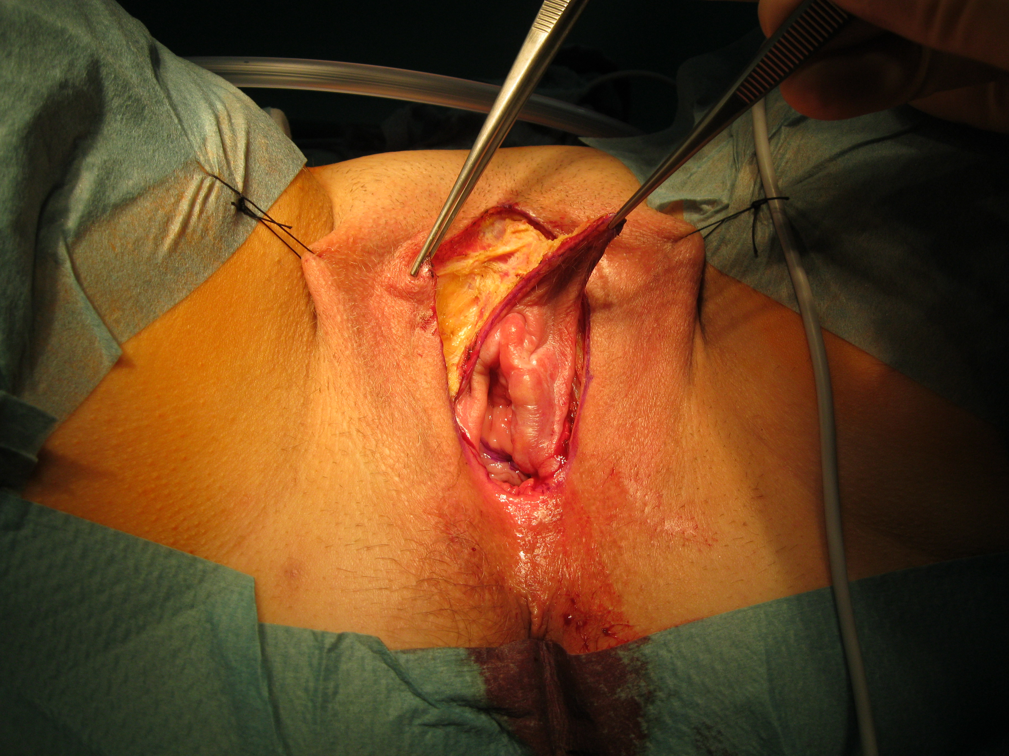
© Sven Mahner 2015

Slide 33
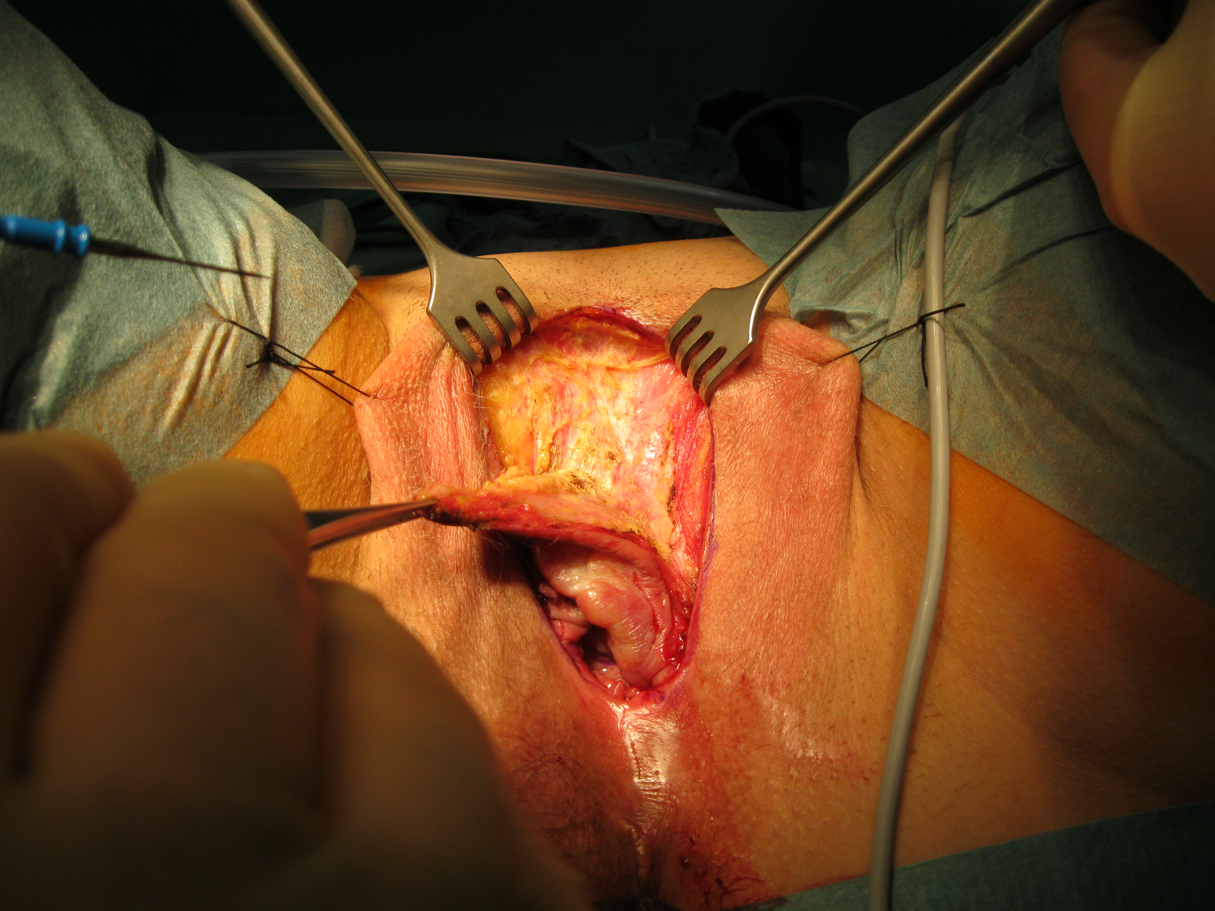
© Sven Mahner 2015

Slide 34
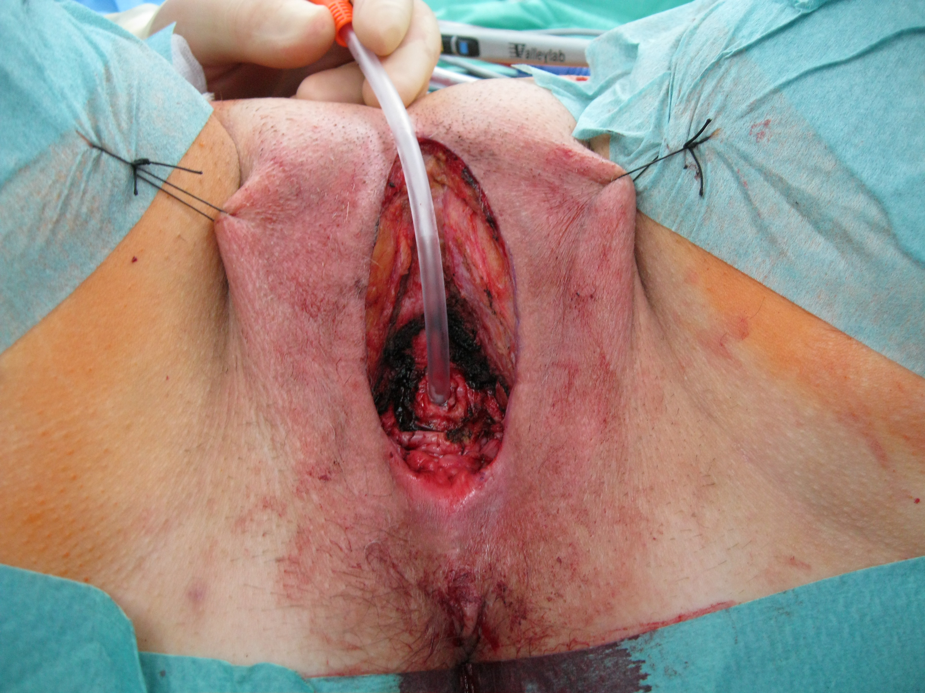
© Sven Mahner 2015

Slide 35
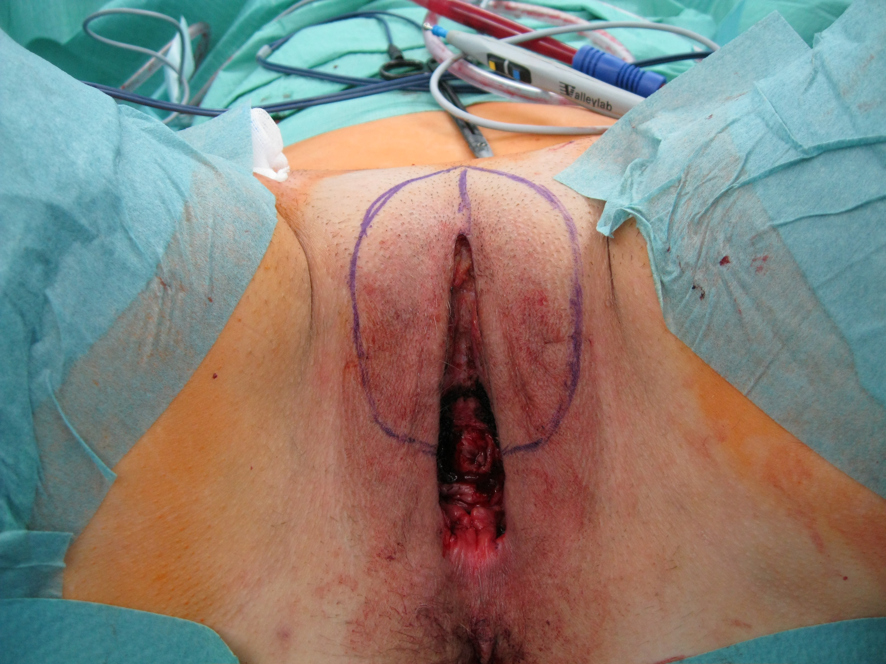
© Sven Mahner 2015

Slide 36
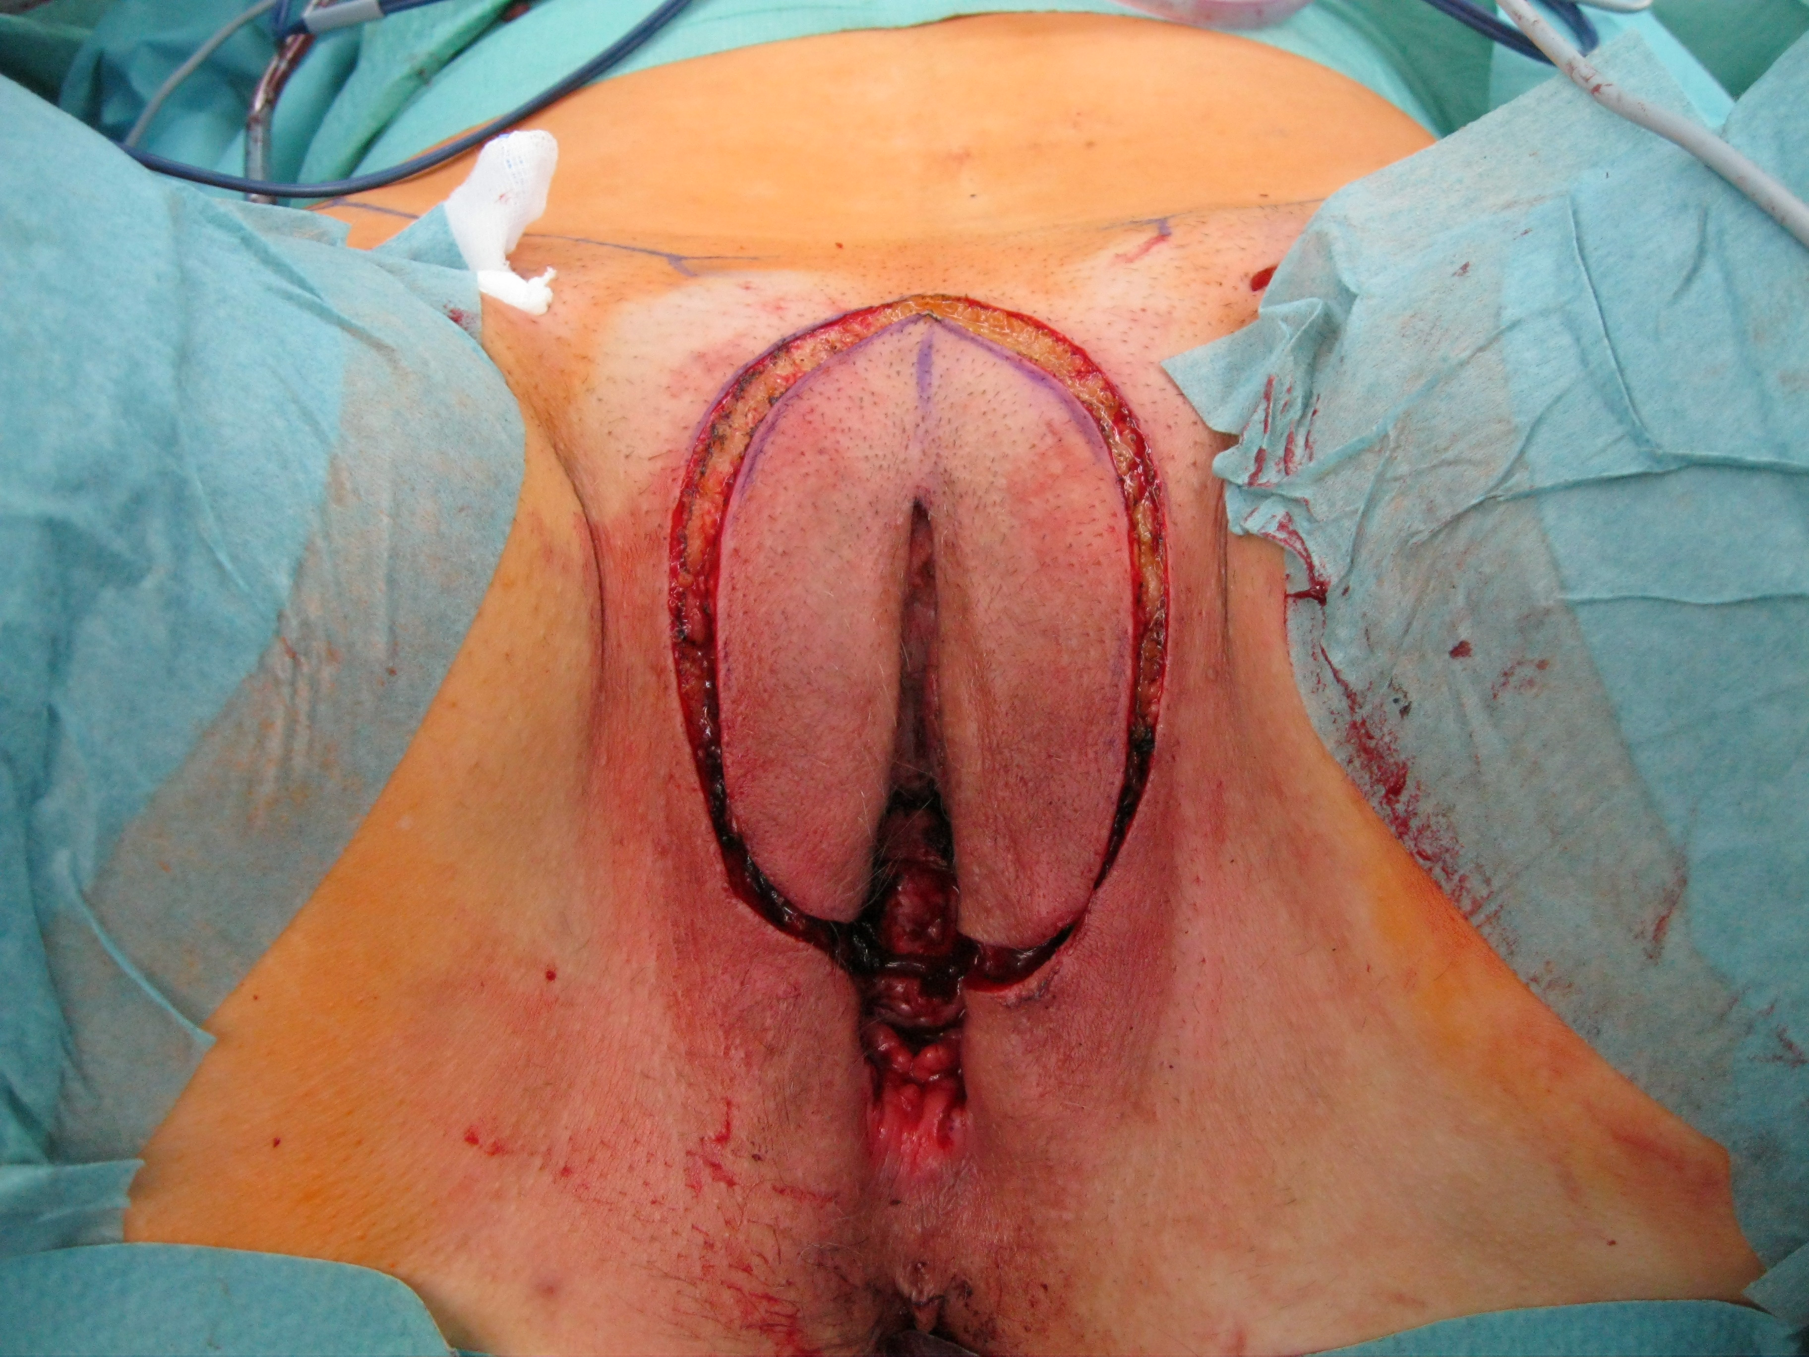
© Sven Mahner 2015

Slide 37
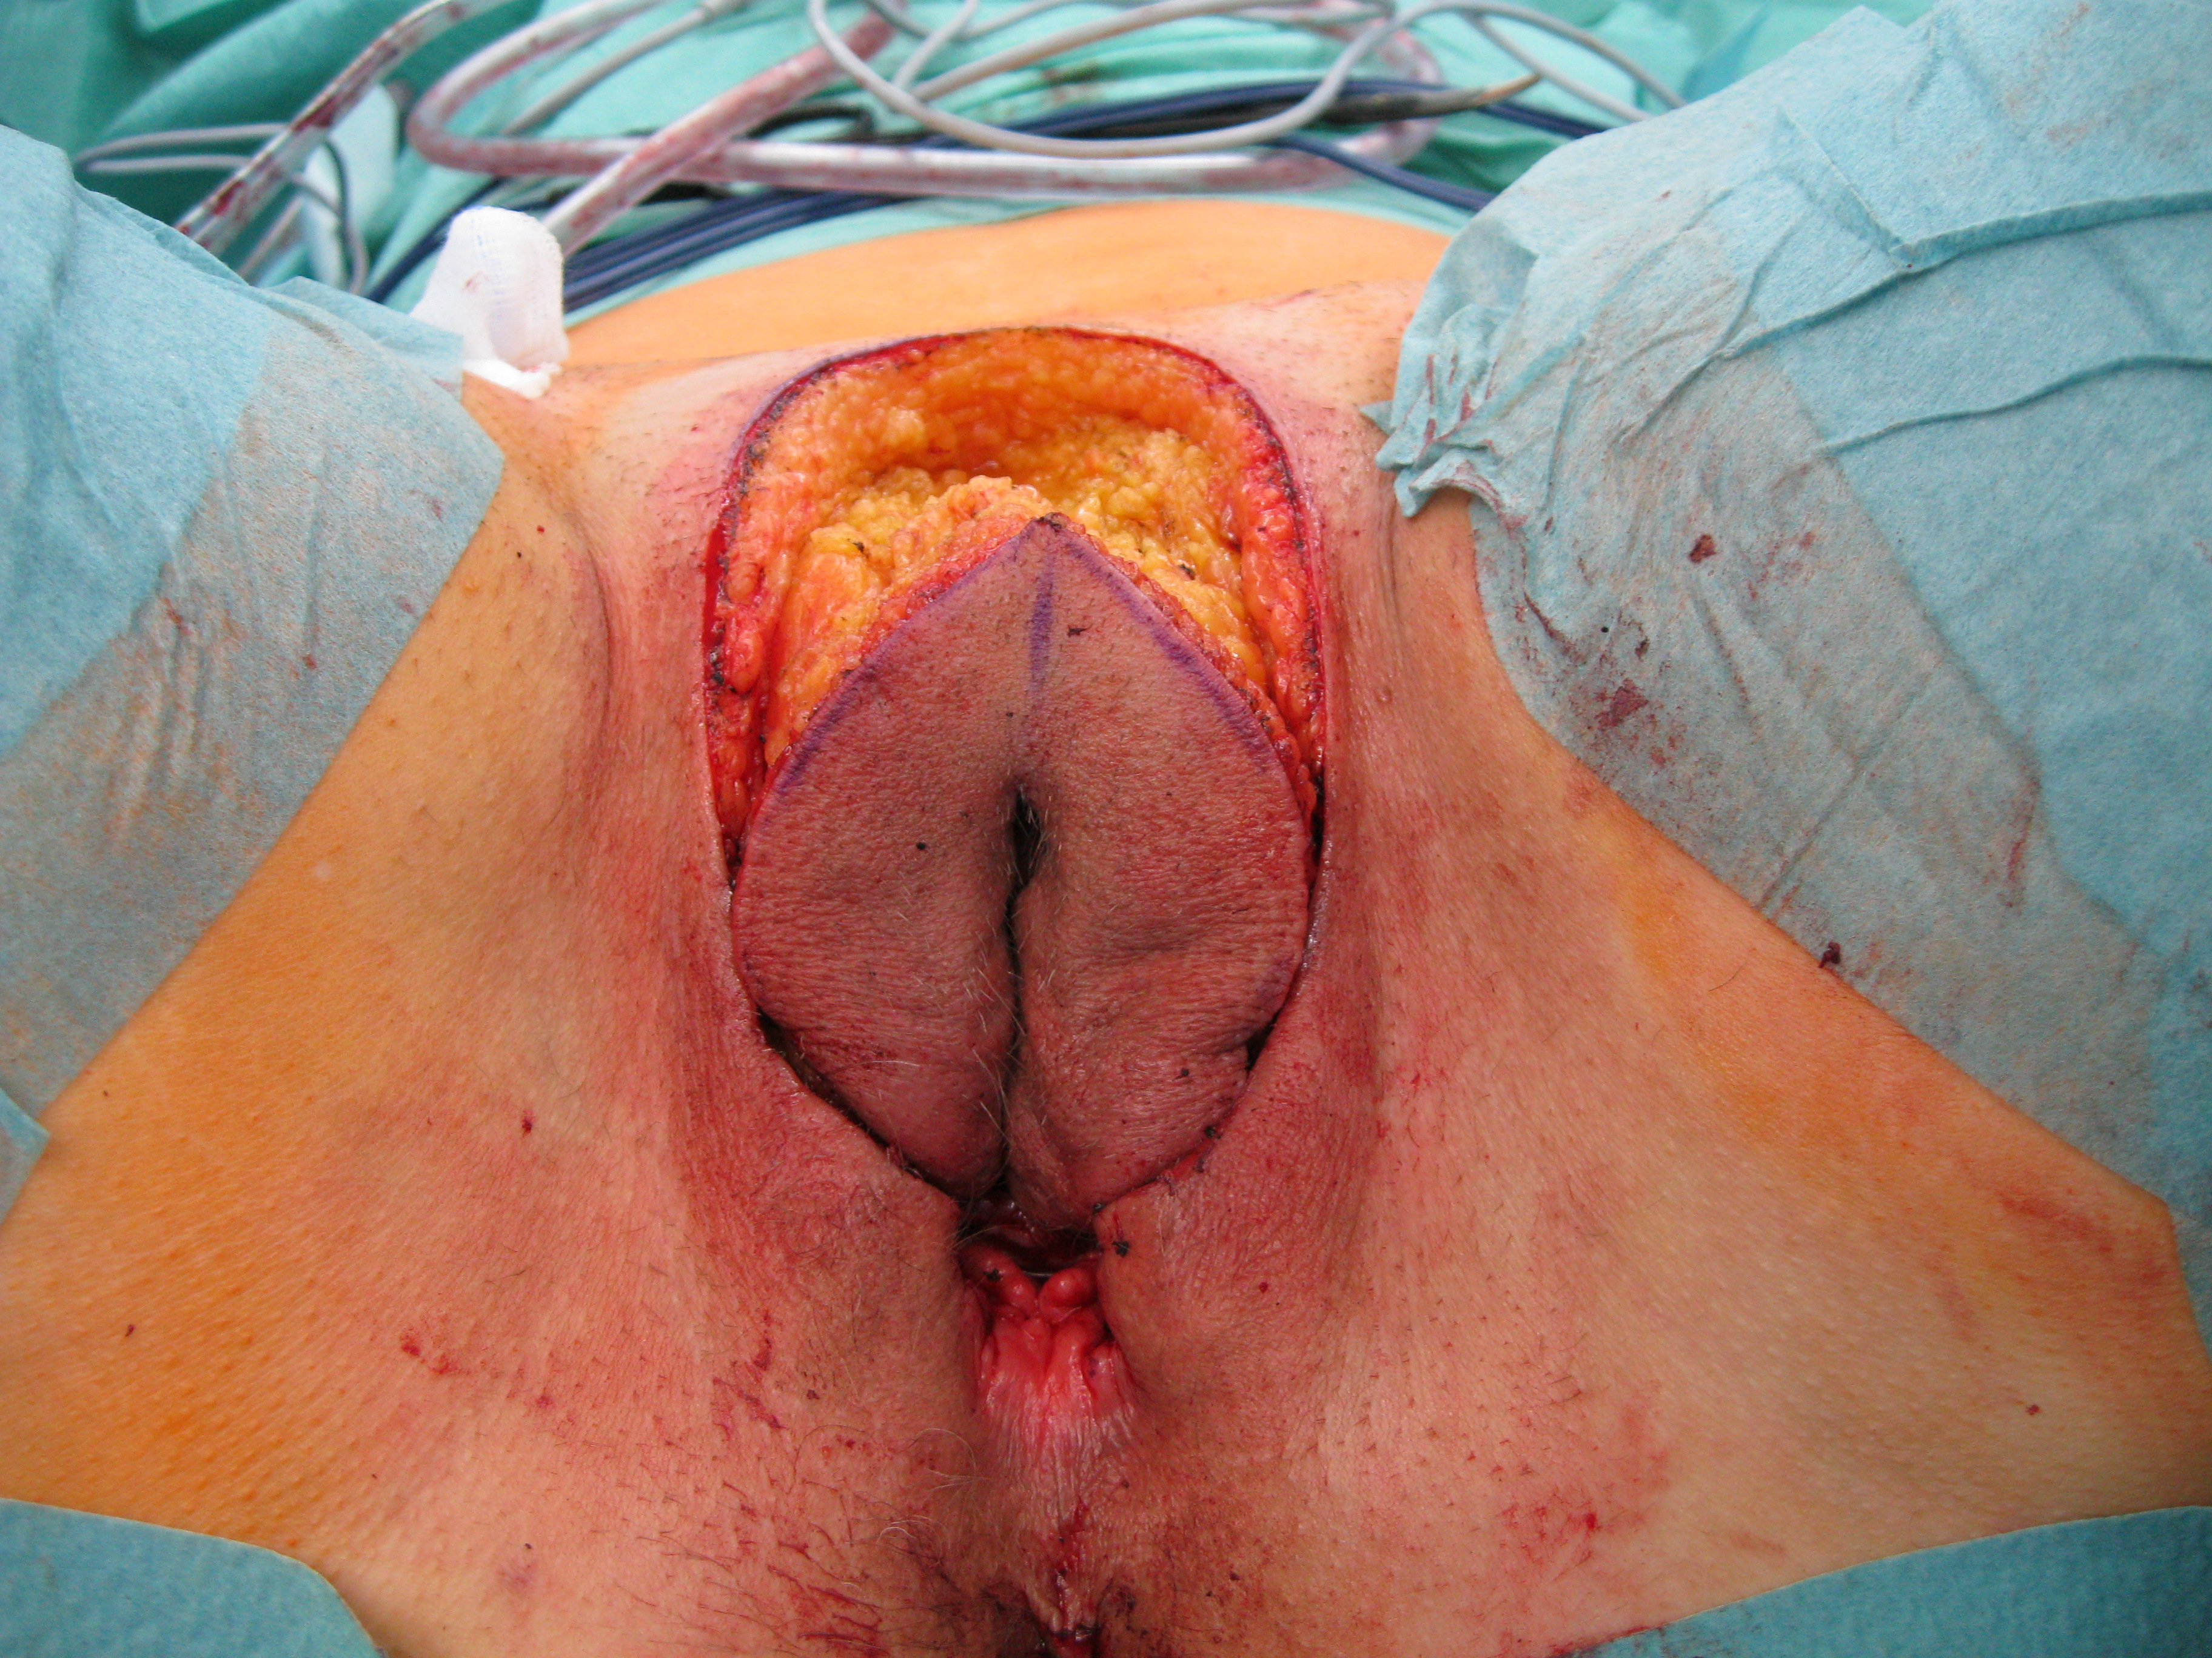
© Sven Mahner 2015

Slide 38
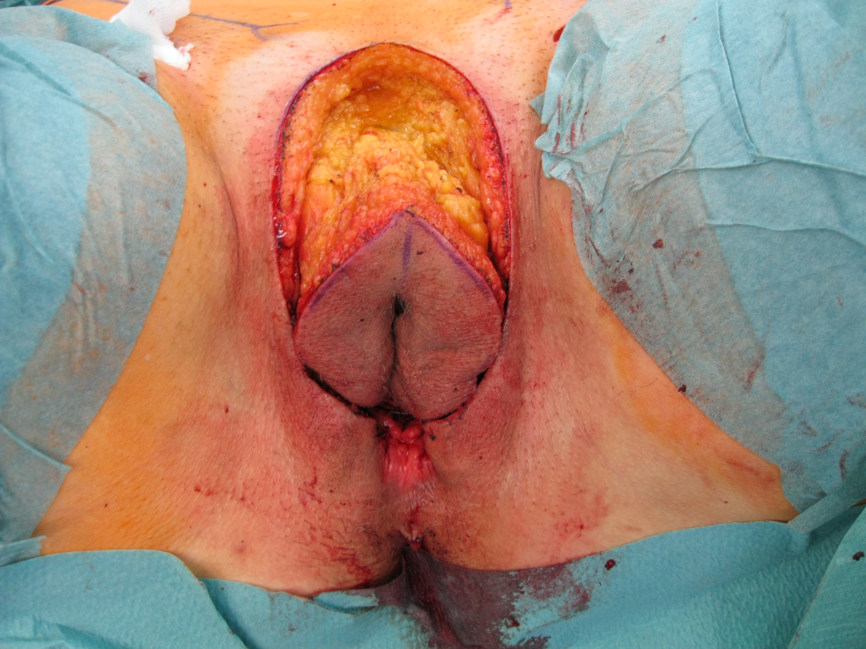
© Sven Mahner 2015

Slide 39
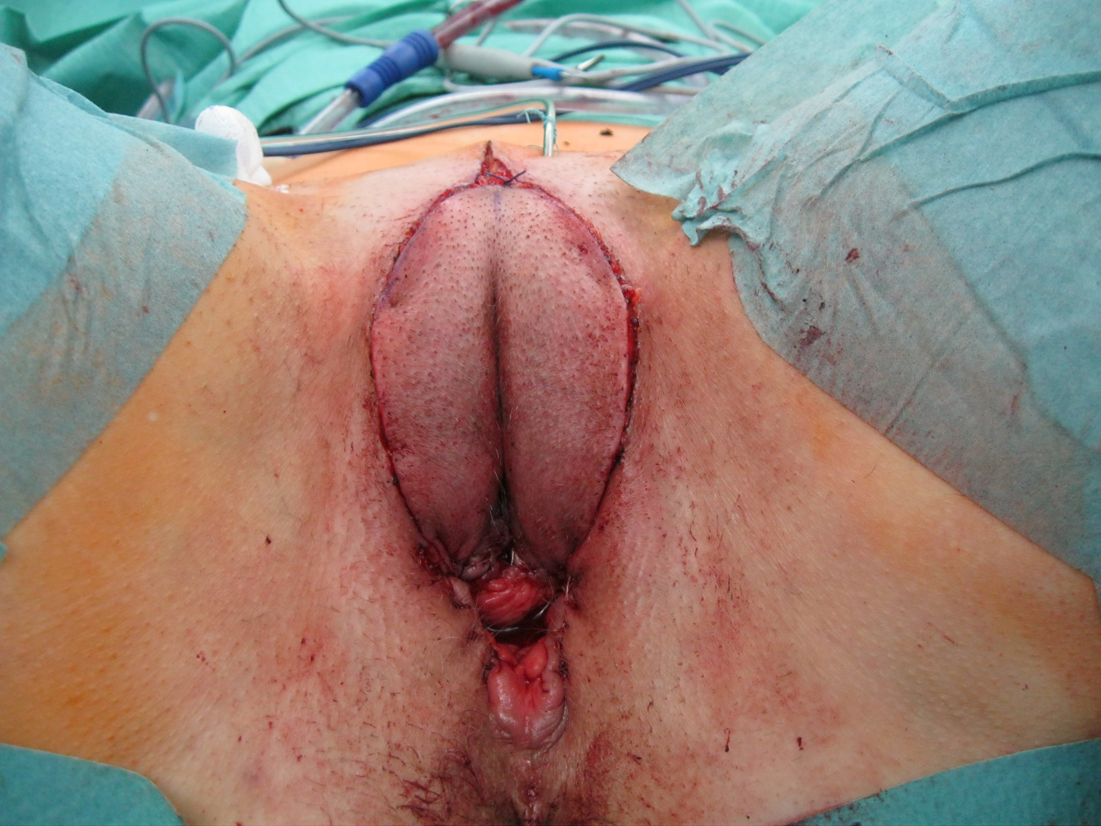
© Sven Mahner 2015

Slide 40
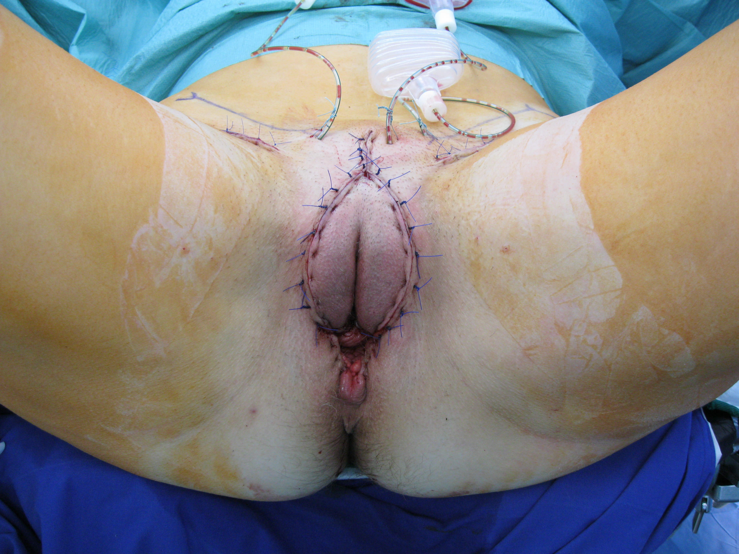
© Sven Mahner 2015

Slide 41
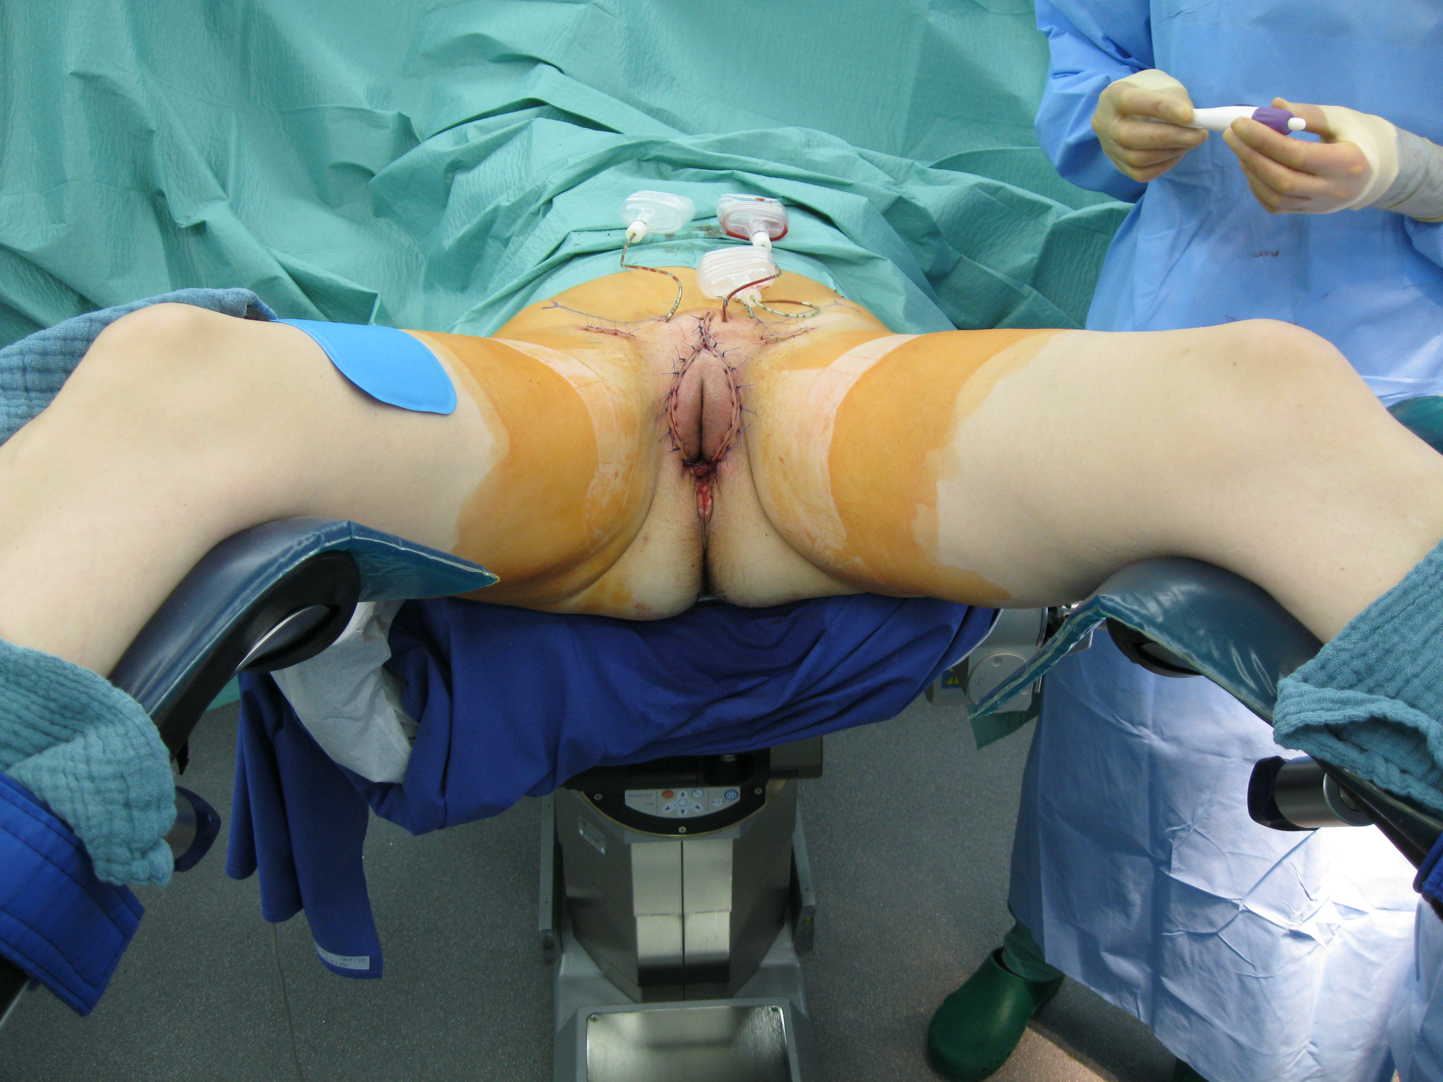
© Sven Mahner 2015

Slide 42
Image not available

Slide 43
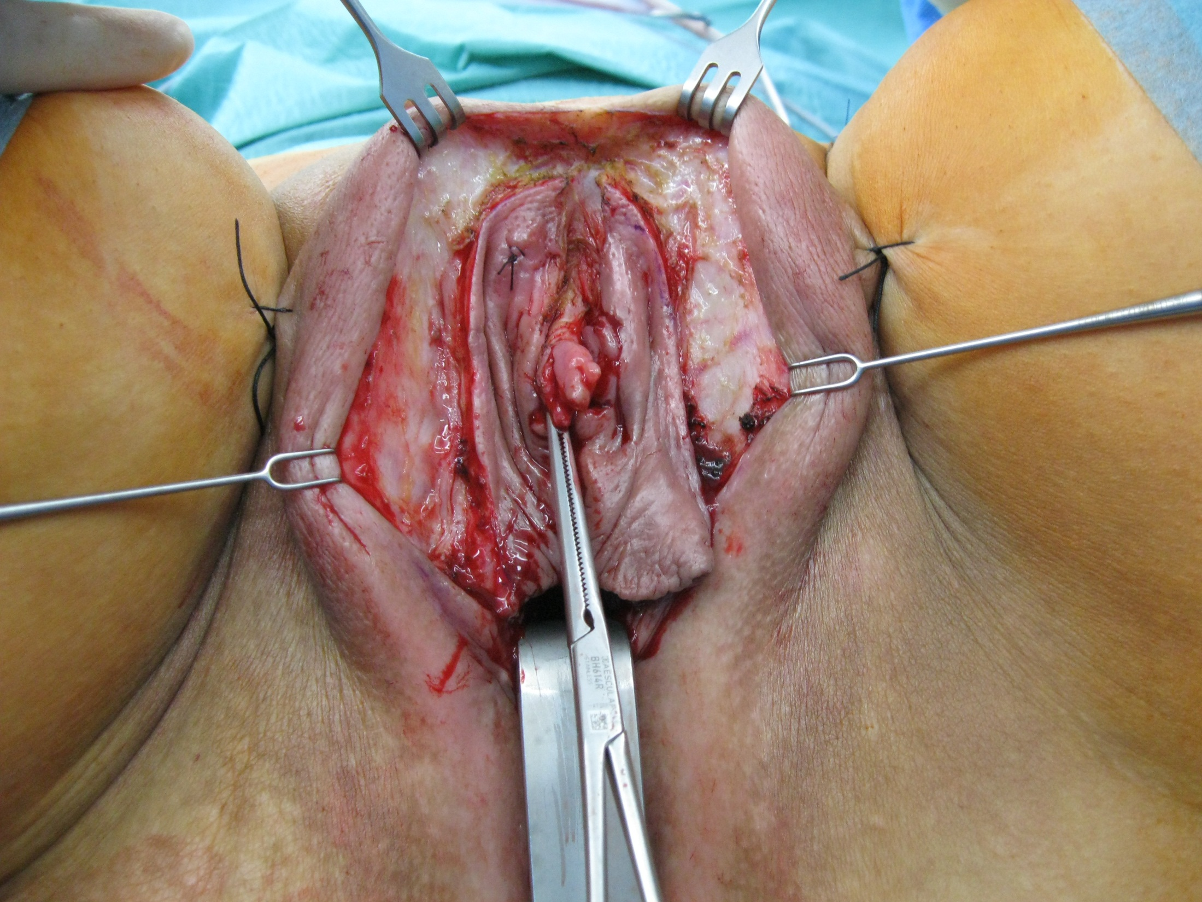
© Sven Mahner 2015

Slide 44
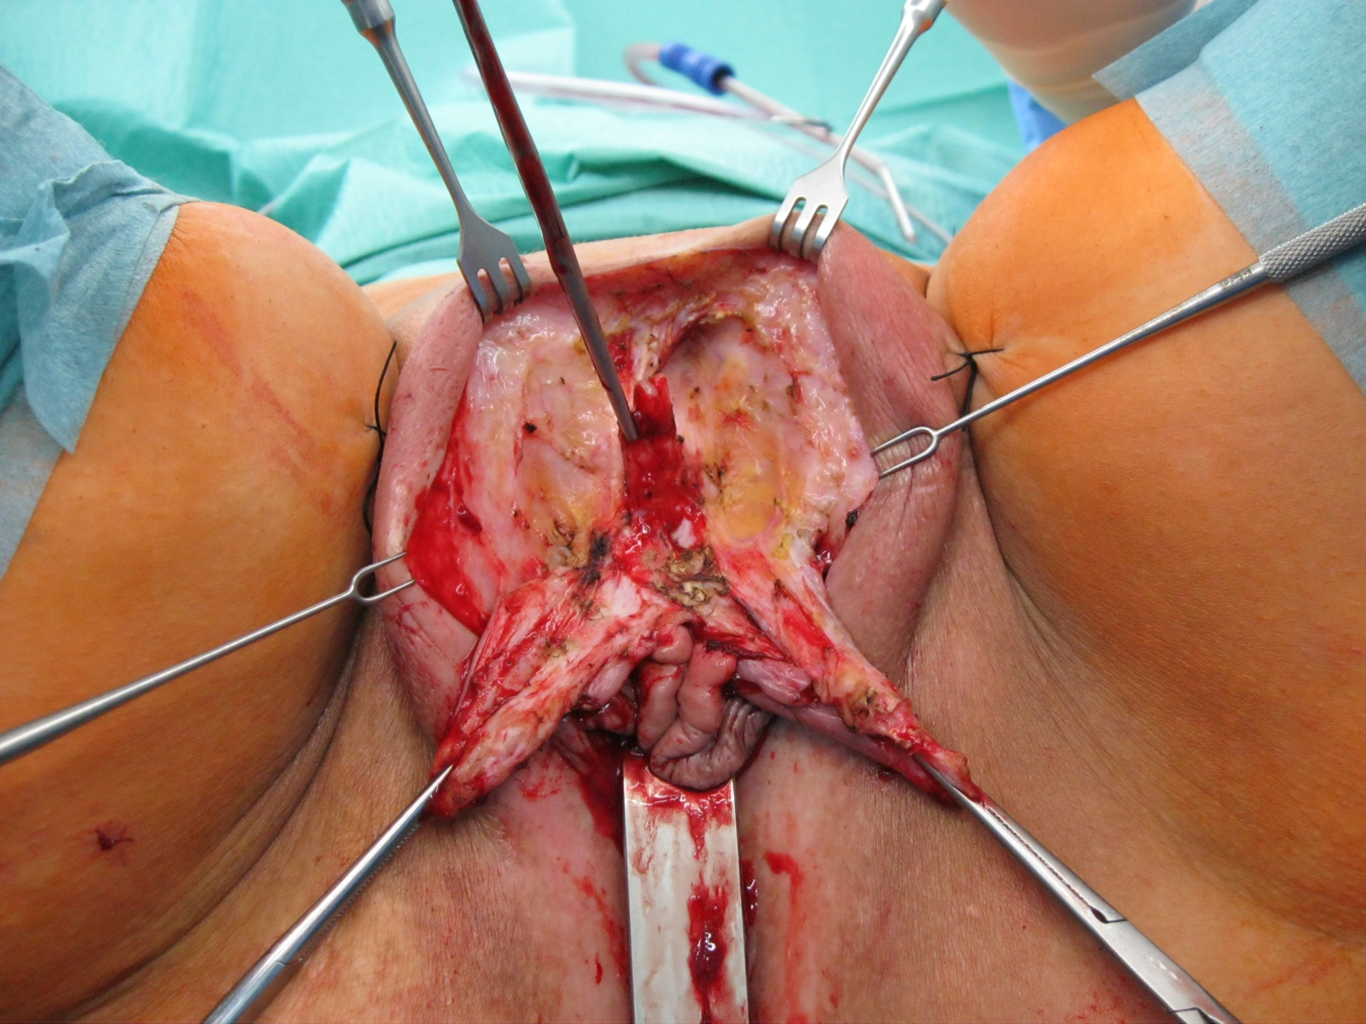
© Sven Mahner 2015

Slide 45
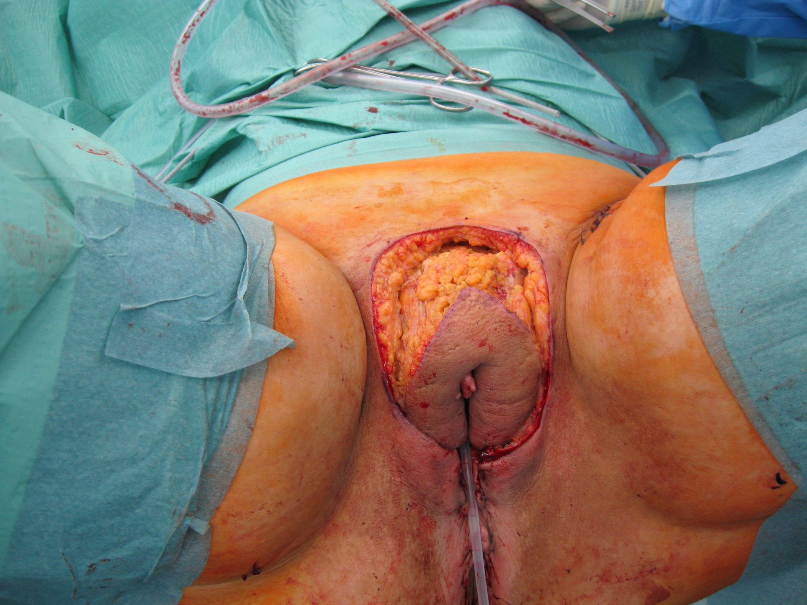
© Sven Mahner 2015

Slide 46
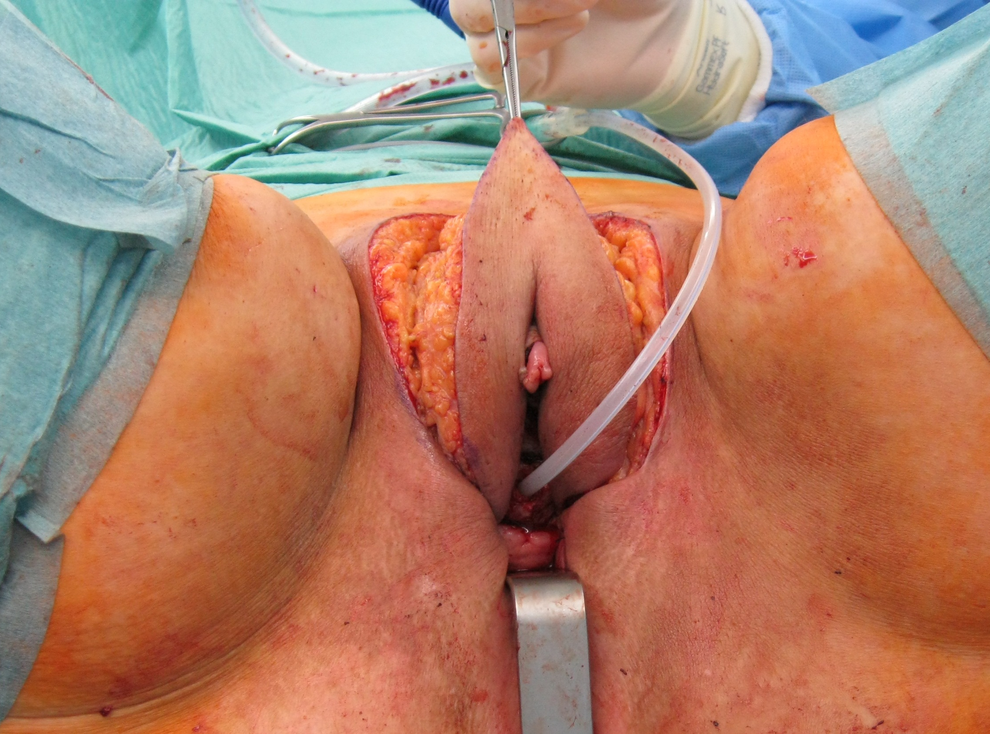
© Sven Mahner 2015

Slide 47
Extreme Cases / Recurrences

Slide 48
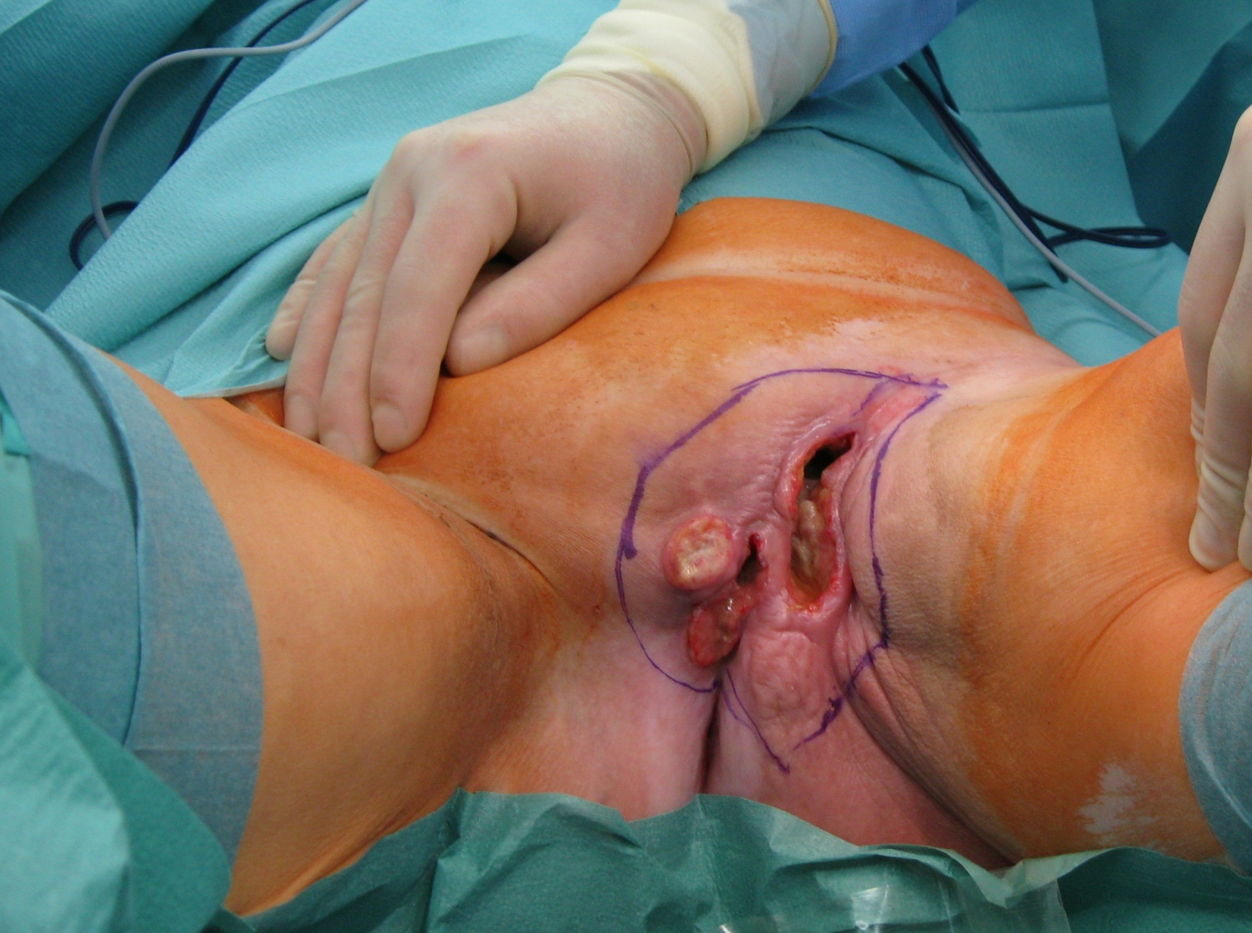
© Sven Mahner 2015

Slide 49
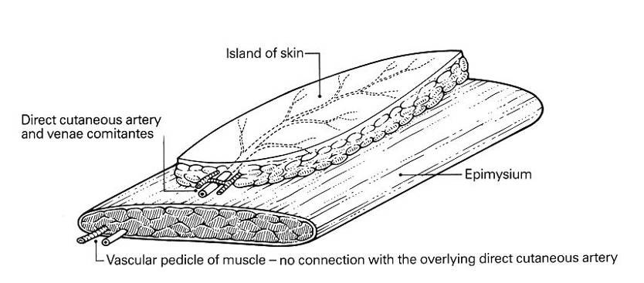
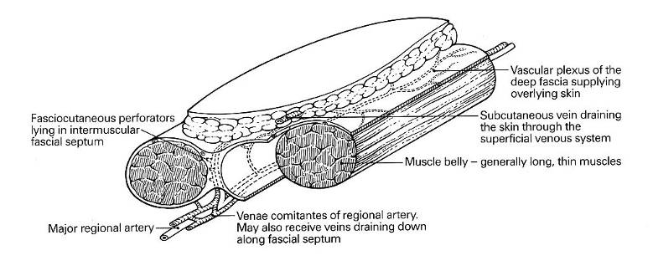
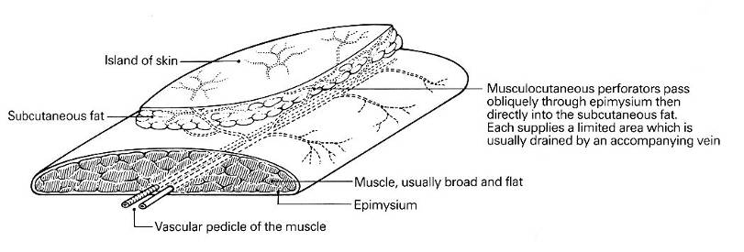
Flaps With Dedicated Blood Supply
Axial/fasciocutaneos flaps
ventral/dorsal bulbocavernous-flap
Glutael lap
Myocutaneal flaps
Gracilis flap
Tensor fasciae latae flap
VRAM

Slide 50
Image not available

Slide 51
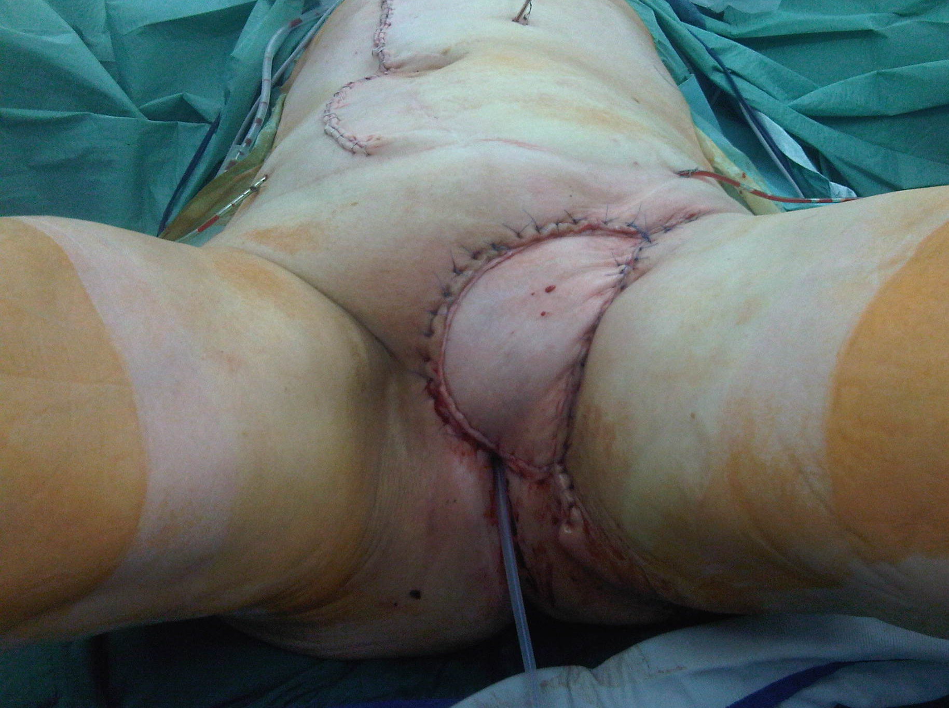
© Sven Mahner 2015

Slide 52
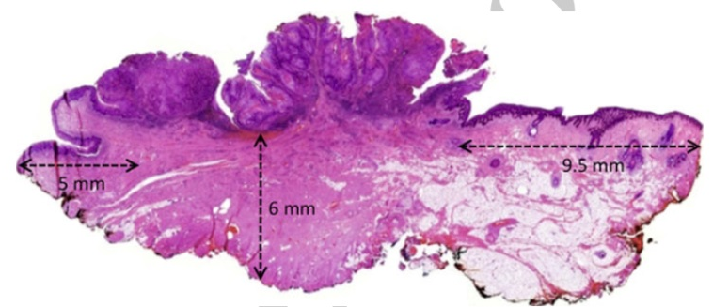
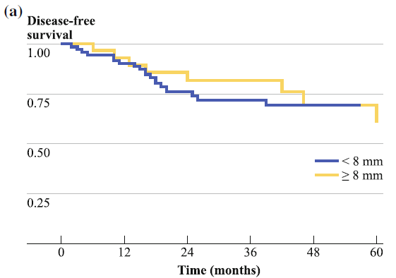
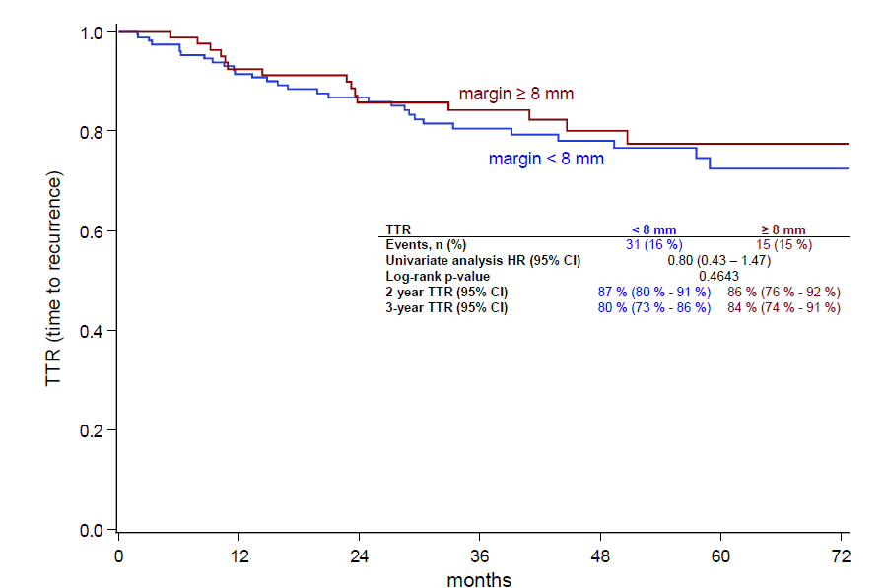
Surgery of the Vulva Tumor-Free Resection Margin
Wölber L, et al. Ann Surg Oncol. 2011;18(13):3811-3818.
Mahner S, et al. Int J Gynecol Cancer. 2014;24(Suppl 4 9): Abstract 0827.

Slide 53
Key Aspects of Vulvar Cancer Treatment:
Surgery of the vulva
Surgery of the groin
Adjuvant treatment

Slide 54
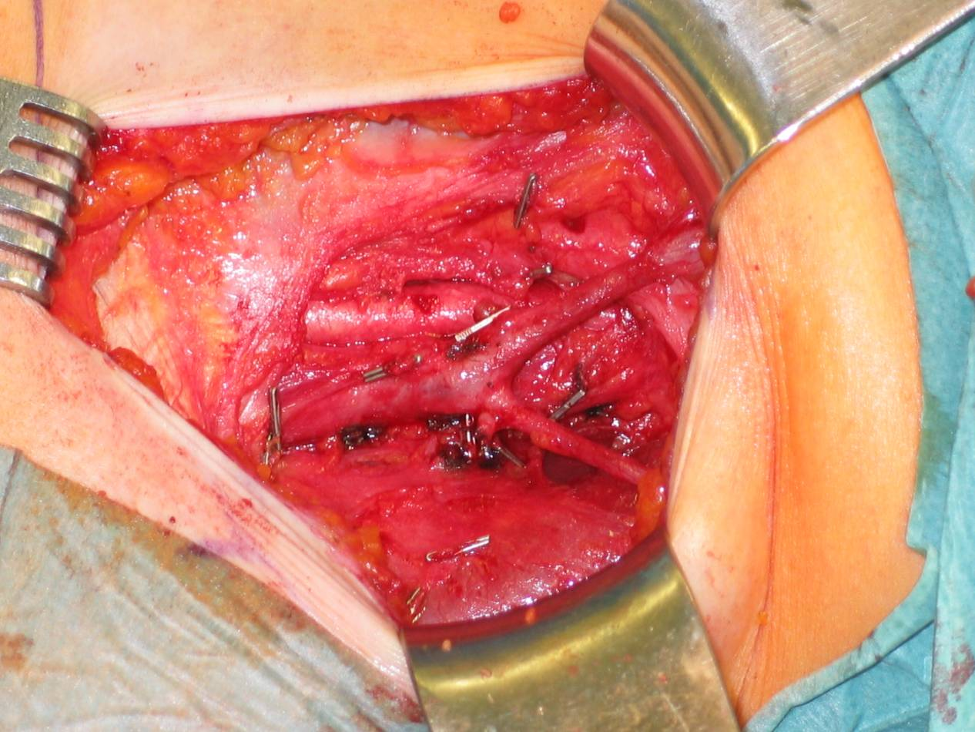
Surgery of the Groin
Befallene LK
Wölber L, et al. Int J Gynecol Cancer. 2012;22(3):503-508.

Slide 55
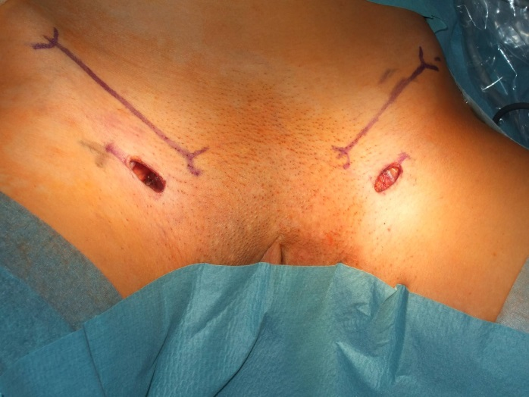
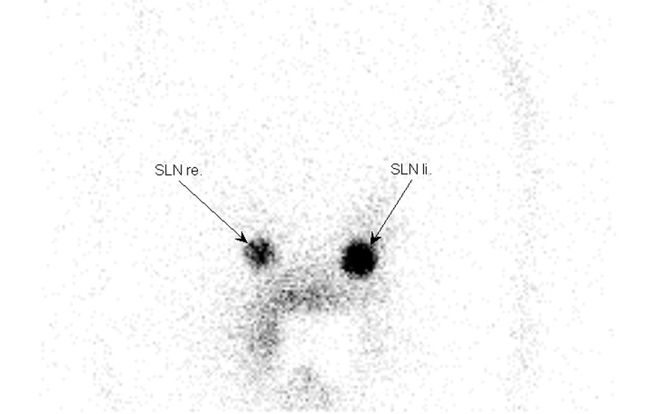
Surgery of the Groin
Befallene LK
Sentinel lymph node dissection
Wölber L, et al. Int J Gynecol Cancer. 2012;22(3):503-508.
Van der Zee AG, et al. J Clin Oncol. 2008;26(6):884-889.

Slide 56
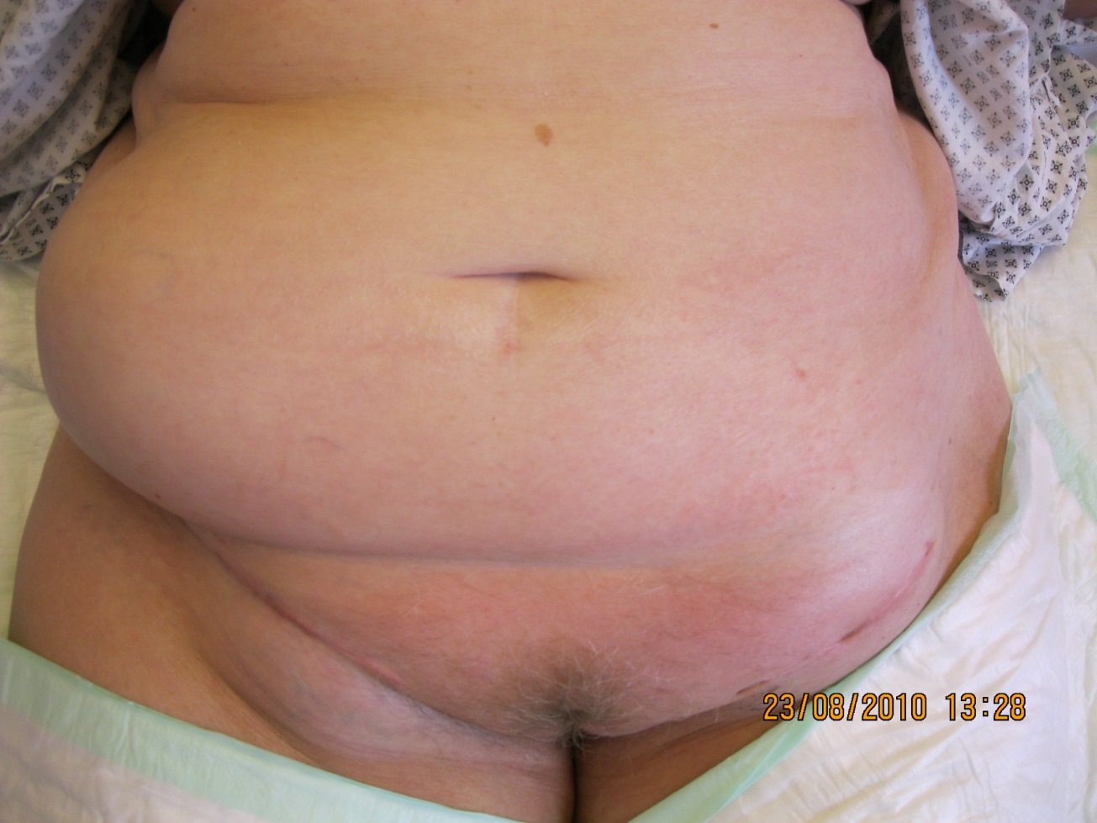
Lymphocysts
© Sven Mahner 2015
Notes:
56
Several generations of improvements in surgical techniques reduced the radicality of resection of the primary tumor and the incidence of infection and wound breakdown. Unfortunately lymphedema remains a common side effect of lymphadenectomy and is generally irreversible.

Slide 57
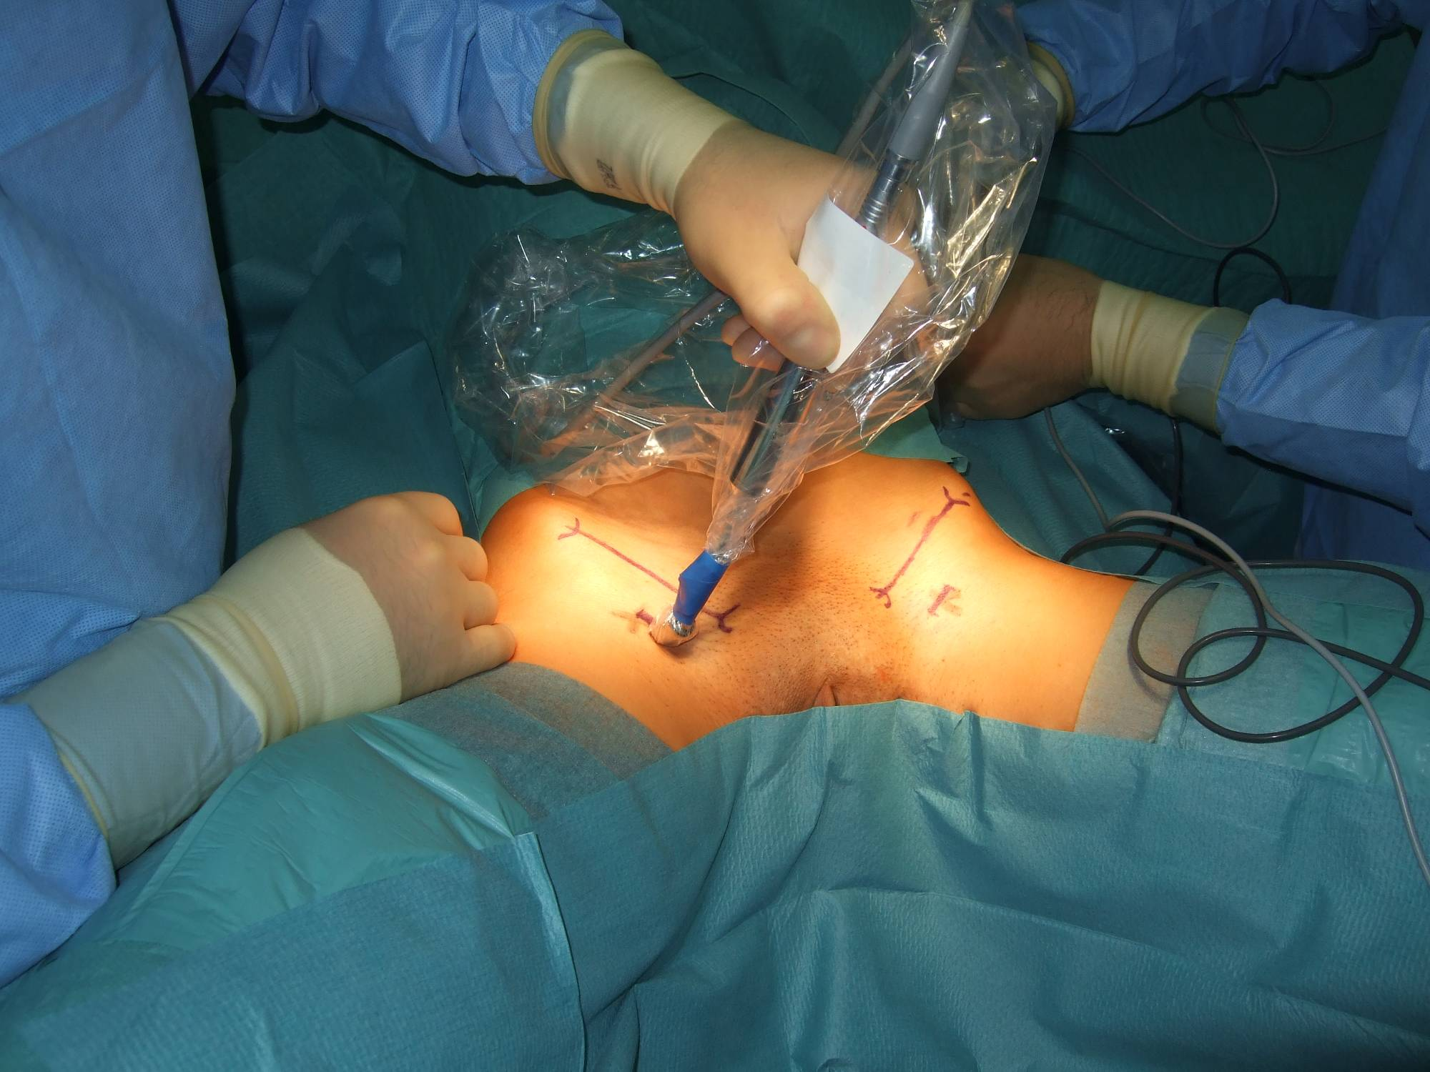
© Sven Mahner 2015

Slide 58
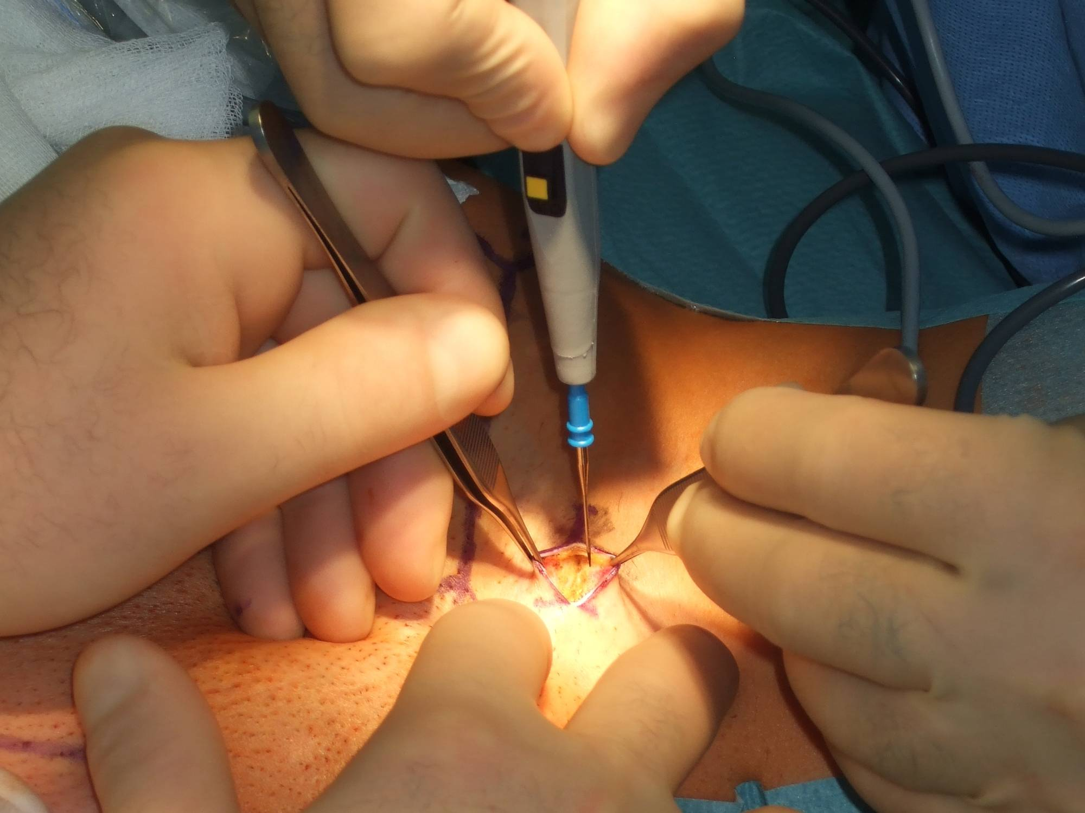
© Sven Mahner 2015

Slide 59
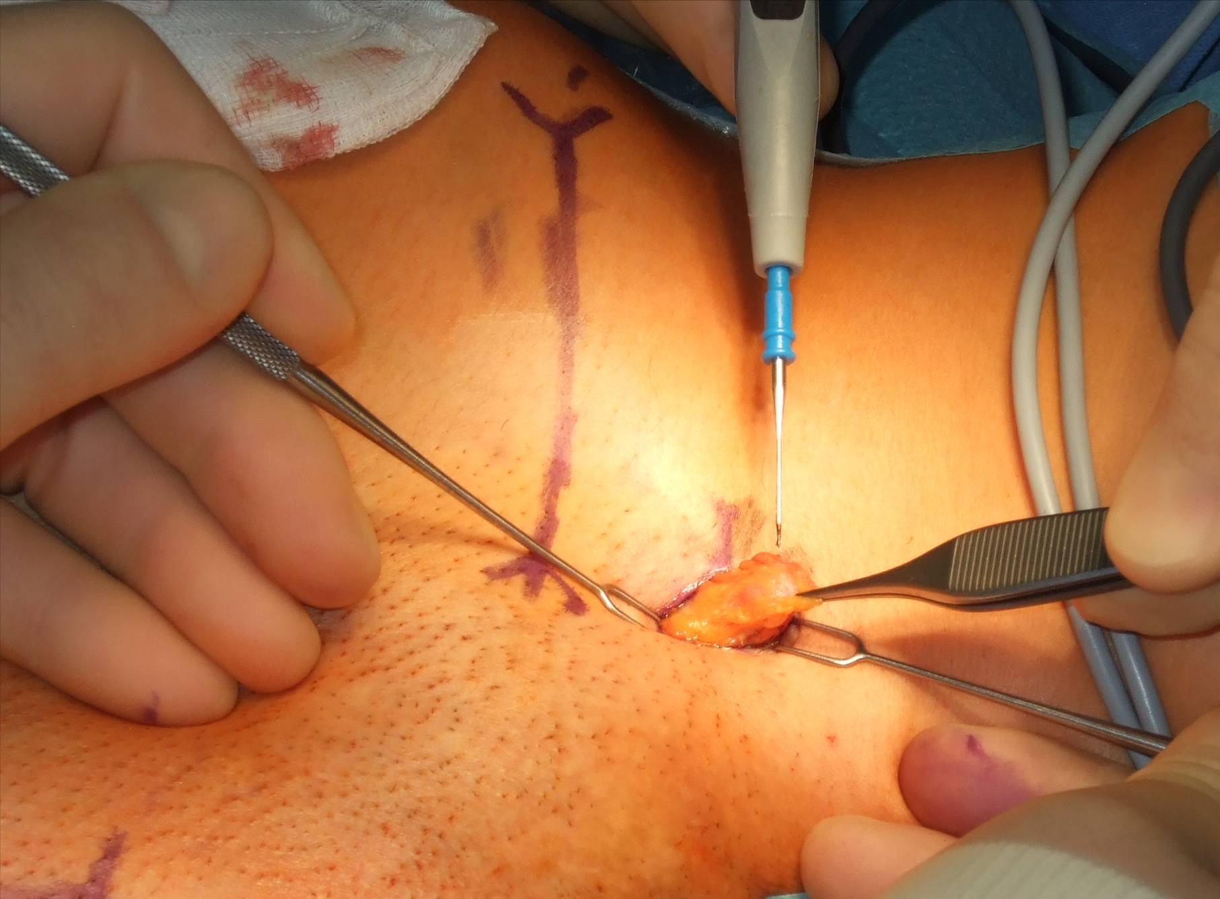
© Sven Mahner 2015

Slide 60
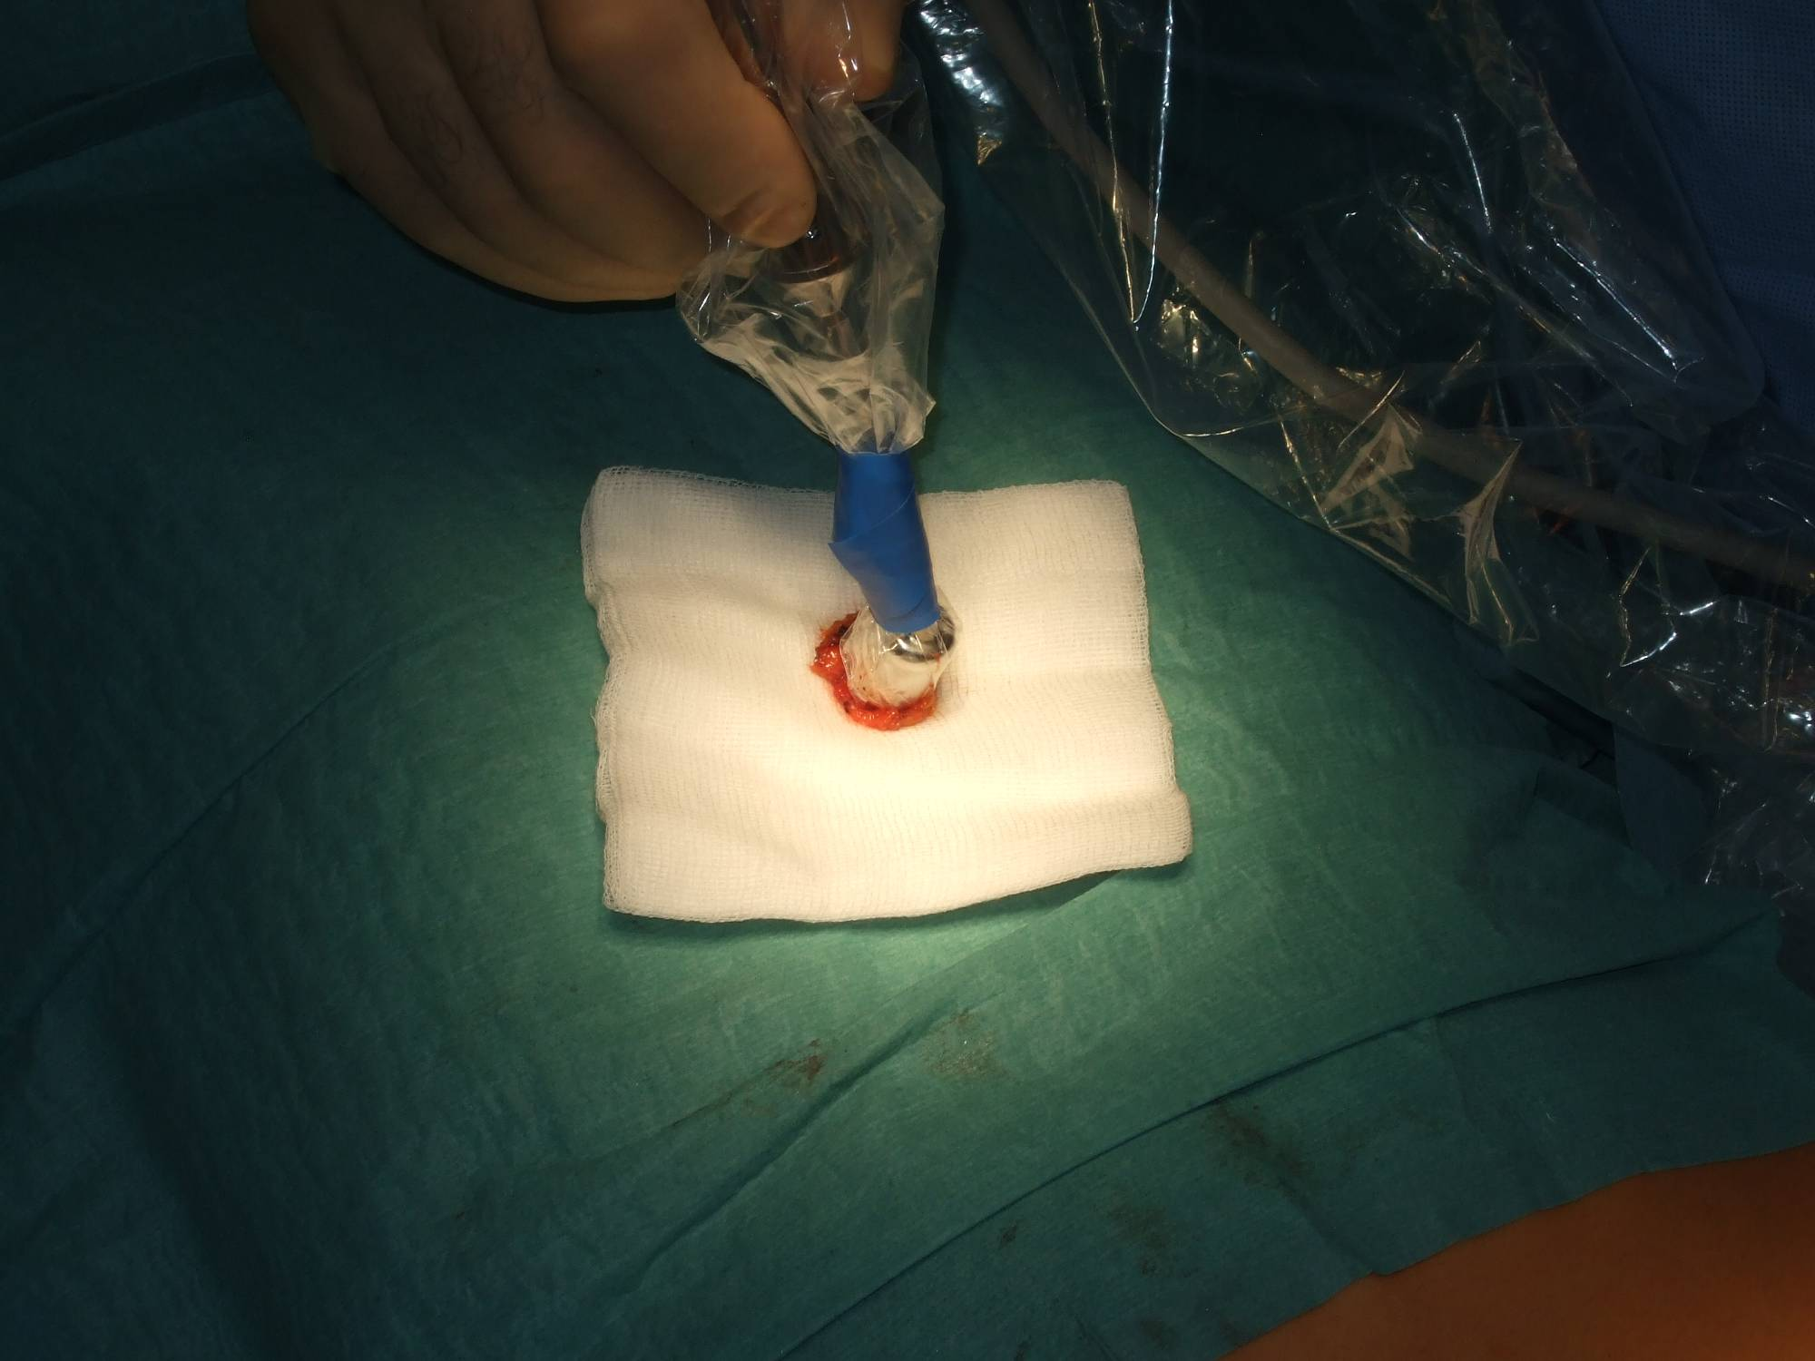
© Sven Mahner 2015

Slide 61
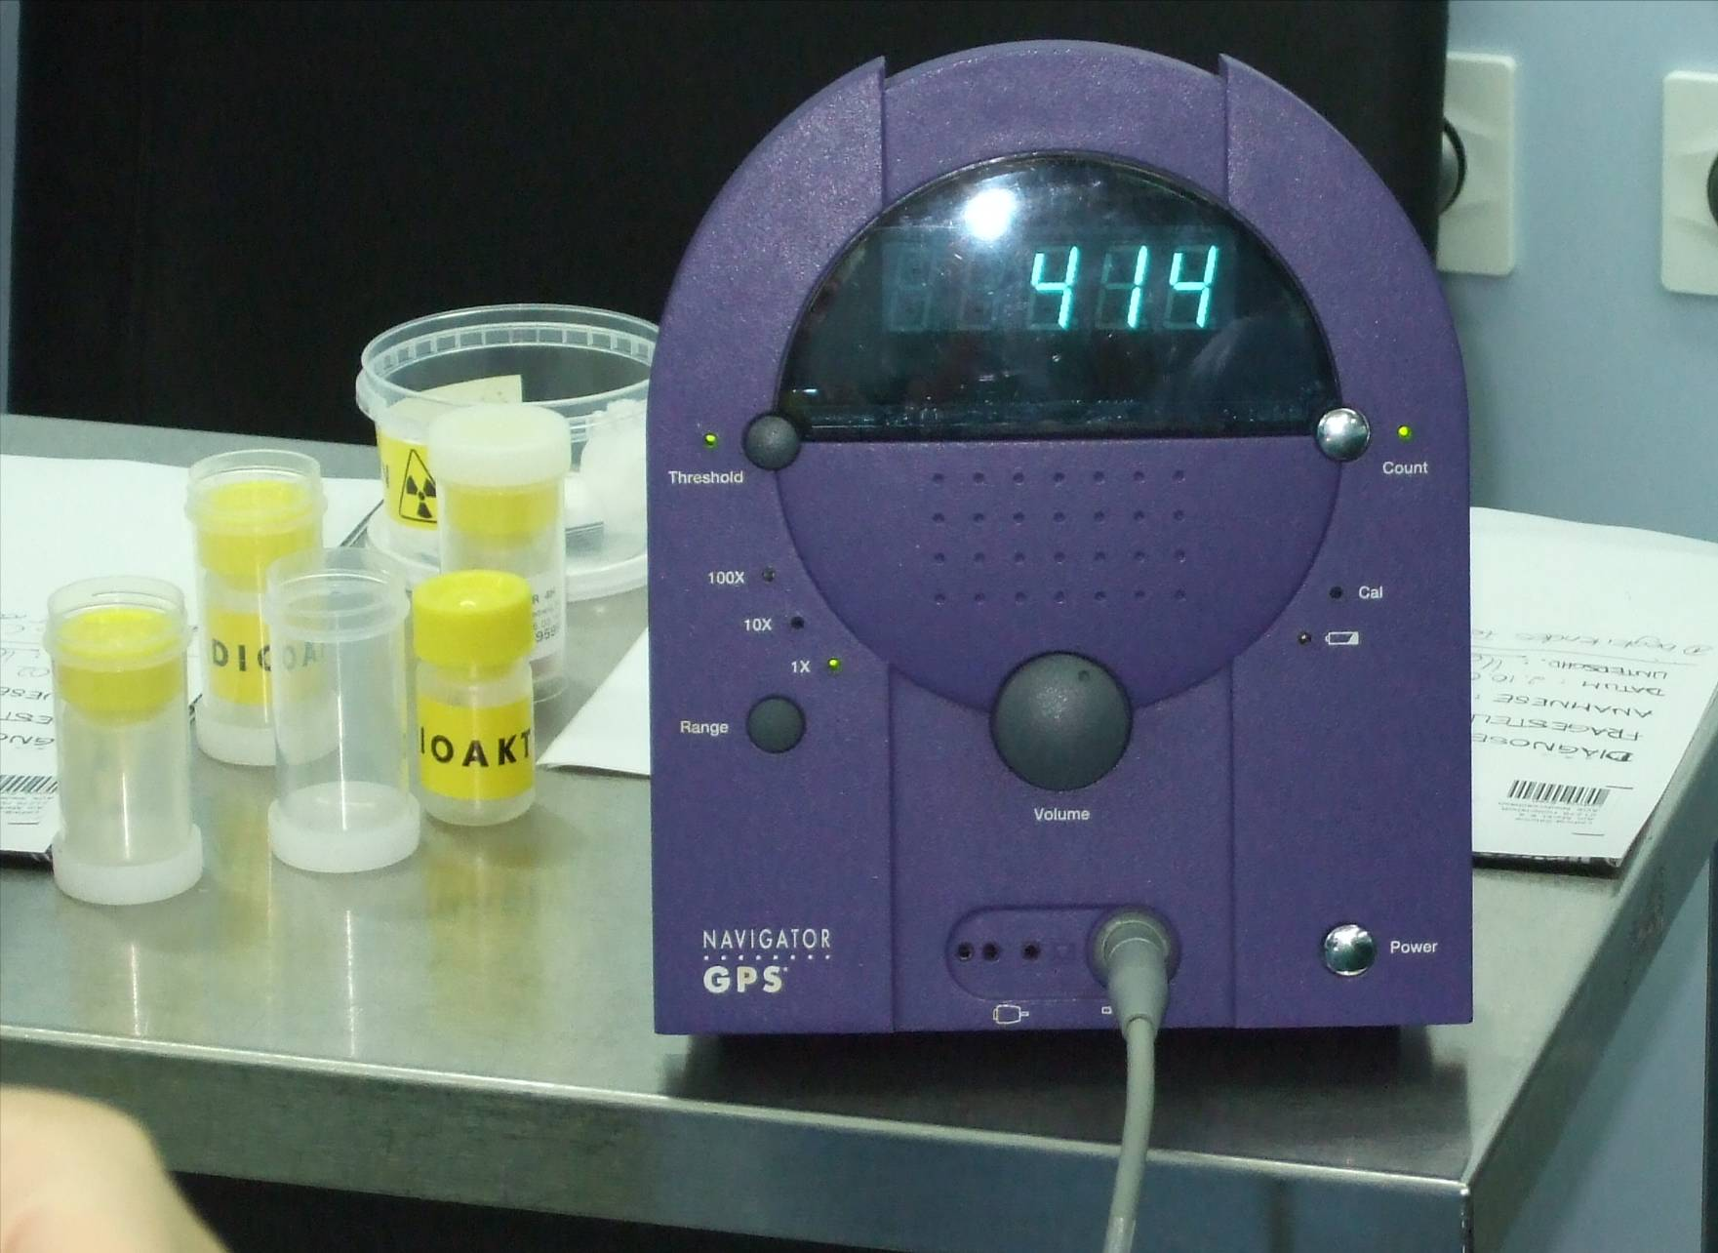
© Sven Mahner 2015

Slide 62

© Sven Mahner 2015

Slide 63
© Sven Mahner 2015

Slide 64
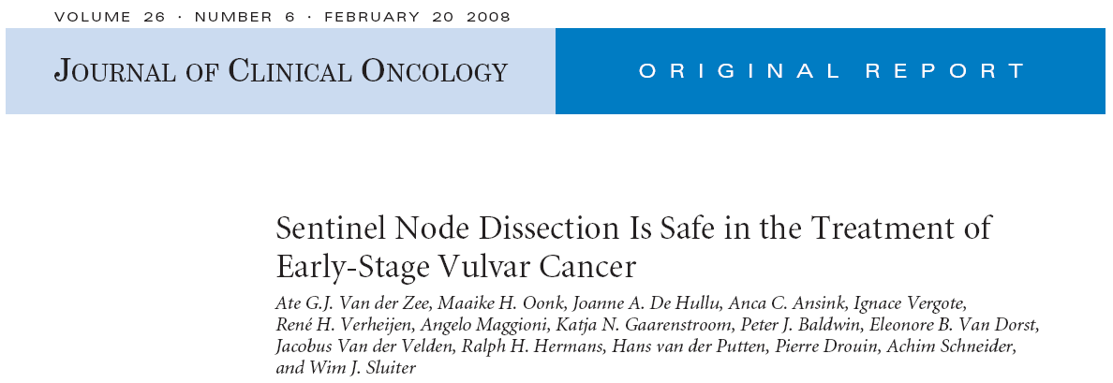
403 pts T1/2 <4 cm, 259 pts pN0(sn)
Ultrastaging of SNL (42% of positive nodes were detected this way)
6 groin recurrences (2.3%)
Significantly less morbidity
wound breakdown 11.7% vs 34%
infection 4.5% vs 31%
median hospital stay 8 d vs 14 d
lymphedema 1.9% vs 25%

Slide 65
Key Aspects of Vulvar Cancer Treatment:
Surgery of the vulva
Surgery of the groin
Adjuvant treatment

Slide 66


Prognostic Role of Lymph Node Metastases in Vulvar Cancer
2-year PFS rate 80% N- vs 40% N+
2-year OS rate 93% N- vs 63% N+
Mahner S, et al. J Natl Cancer Inst. 2015 [in press].

Slide 67

GOG 37 Surgery vs Radiotherapy
Homesley HD, et al. Obstet Gynecol. 1986;68(6):733-740; Kunos C, et al. Obstet Gynecol. 2009;114(3):537-546.

Slide 68


GOG 37 Surgery vs Radiotherapy
Homesley HD, et al. Obstet Gynecol. 1986;68(6):733-740; Kunos C, et al. Obstet Gynecol. 2009;114(3):537-546.

Slide 69

GOG 37 Surgery vs Radiotherapy
Homesley HD, et al. Obstet Gynecol. 1986;68(6):733-740; Kunos C, et al. Obstet Gynecol. 2009;114(3):537-546.

Slide 70
AGO CaRE-1: Adjuvant Radiotherapy in Node-Positive Patients
Mahner S, et al. J Natl Cancer Inst. 2015 [in press].

Slide 71


AGO CaRE-1: Adjuvant Radiotherapy in Node-Positive Patients
Mahner S, et al. J Natl Cancer Inst. 2015 [in press].

Slide 72
AGO CaRE-1: Adjuvant Radiotherapy in Node-Positive Patients
Adjuvant radiotherapy is standard of care for node-positive vulvar cancer
Mahner S, et al. J Natl Cancer Inst. 2015 [in press].

Slide 73
AGO CaRE-2 Study
Patients with node-positive primary vulvar cancer
R
Adjuvant radiotherapy* plus simultaneous chemotherapy with 6 cycles cisplatinum 40 mg/m²
Adjuvant radiotherapy*
* Radiotherapy fields per institutional standards

Slide 74
Conclusion: Current Status of Treatment for Vulvar Cancer
Surgical resection with clear margins
Indication for plastic reconstruction
Sentinel node dissection whenever indicated
Adjuvant radiotherapy in patients with positive lymph nodes
Trial on adjuvant chemoradiation next step to improve outcome of node-positive patients

